Slide 1
Claim Evidence Reasoning
APK (Accessing Prior Knowledge): How would you define the terms claim, evidence, and reasoning?
What do the terms claim, evidence, and reasoning make you think of?

Slide 2
Claim – a statement that answers a question
Evidence – observations, data tables, graphs, pictures
Reasoning – scientific principles, readings, formulas that describe why the evidence supports the claim

Slide 3
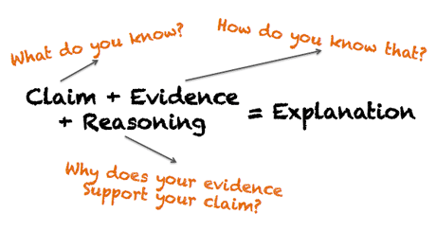

Slide 4
When? We use CER-based narratives after completing a lesson.
Why? CER-based narratives allow you to make connections between the lesson and the lab. Also, learning how to write in science is very important to your education as a whole.
How? CER-based narratives are set up in a paragraph form (usually 5-7 sentences in length). There are times when it is necessary to include a data table, graph, or picture in with your evidence.

Slide 5
https://www.youtube.com/watch?v=WQTsue0lKBk
What is her claim?
What is her evidence?
What is her reasoning? (connects the evidence to her claim)

Slide 6
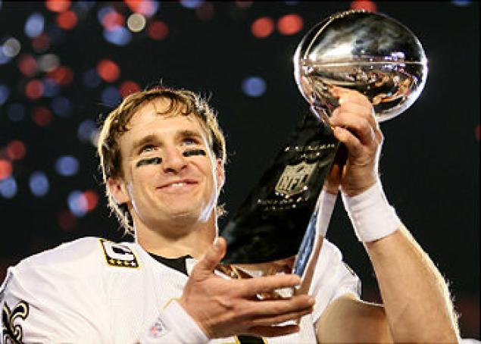
If the Focus Question is, “Who is the best NFL quarterback?
Claim: Drew Brees is the best quarterback in the NFL.

Slide 7
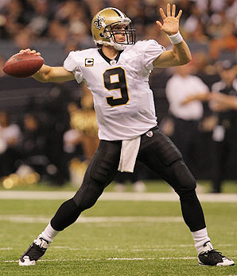
Evidence:
His completion percentage is 59.4 and he has 36 touchdowns in his career from 2012-2013.
The evidence includes data.

Slide 8
Reasoning:
According to Sports Illustrated, Drew Brees is able to adjust to the defense during the game and come back with a different plan of attack.
You may use information from text to support your claim and evidence.

Slide 9
Each corner of the room is represented by a letter, either A, B, C, or D. The following few slides are multiple choice questions. After I read the question and possible answers and tell you it is okay to move, go to the corner of the room that you believe is the correct answer.

Slide 10
Which one of the following do you believe best represents the definition for a “claim”?
A. A statement that expresses the answer or conclusion to a question or problem.
B. A question that somebody might ask.
C. A response to a question.
D. A statement that does NOT answer a question.

Slide 11
Which one of the following do you believe best represents the definition for “evidence”?
A. Information that does not appropriately support the claim.
B. A statement that answers a question.
Scientific data that supports the claim.
A question that supports the claim.

Slide 12
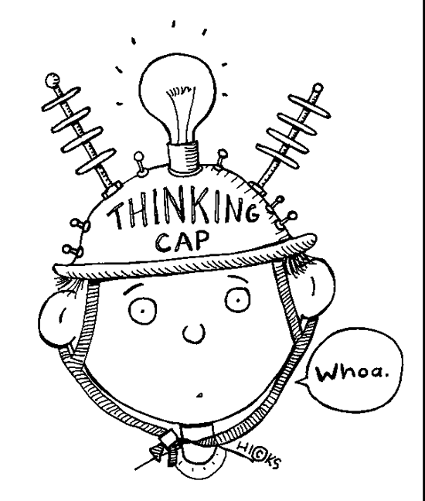
Which one of the following do you believe best represents the definition for “reasoning”?
A. A graph and a data table
A collection of scientific principles, textual information, and prior knowledge that supports the claim.
A statement that answers a question.
The objective of the lesson.

Slide 13
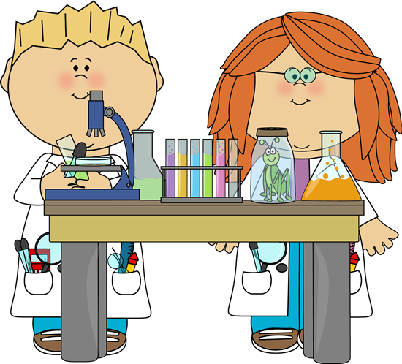
Now back to science…
How to write a CER-based narrative using a science example.
Take out your “Reflect” Sheet from Lesson 2.

Slide 14
*Title of Lesson: Sink or Float???
*Question: What fruit will float?
https://www.youtube.com/watch?v=vSXTBnnx4OA

Slide 15
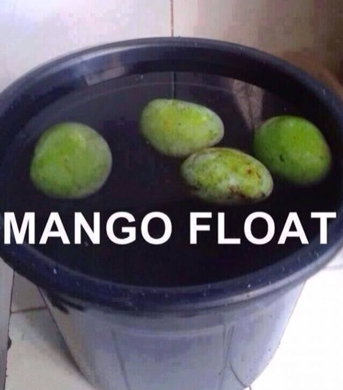
Focus Question: What fruit will float?
Claim: (Answer the focus question) Your “claim” is also your hypothesis. Your educated guess. For example, “I think the mango will float in the water”

Slide 16
Evidence: (What did you do in the lab that supports your claim?)
“I know this because in the lab we…”
Measured the weight of each fruit and recorded results
Placed the fruit in the water and observed the results
Explanation: (What did you learn while doing the lab, listening in class, or reading the textbook that supports your claim?)
“In class we learned/read that…”
- Density depends on how much “space” an object takes up

Slide 17
Conclusion: (Restate your claim and include an explanation) The fruit that will float is the watermelon. Although the watermelon weighed the most, the particles are loosely compacted together. This means that the watermelon consists of more space than the other fruits tested in the water.

