Slide 1
What process forms sediments?

Slide 2
Weathering

Slide 3
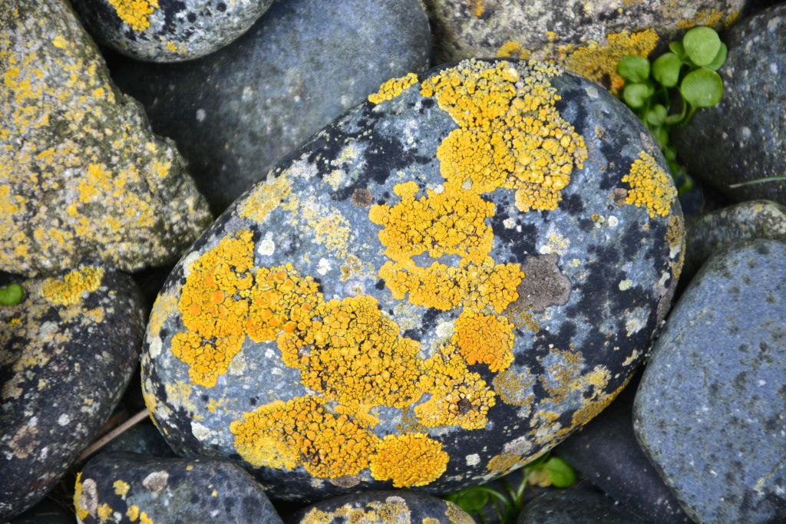
What is this an example of?

Slide 4
Chemical Weathering – Acid in Living Things

Slide 5
What process creates cracks in rocks using water and expansion?

Slide 6
Mechanical Weathering by Ice Wedging or Frost Wedging

Slide 7
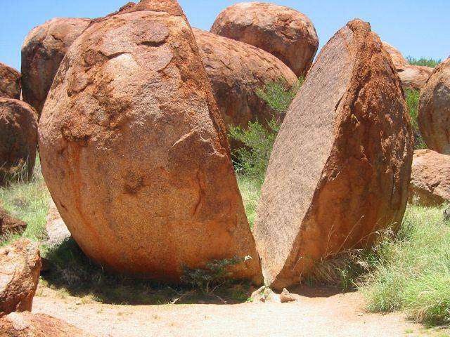
What is this an example of?

Slide 8
Mechanical Weathering – Ice Wedging

Slide 9
This creates U shaped Valleys.

Slide 10
Glaciers

Slide 11
Oxidation forms what?

Slide 12
Rust

Slide 13
What is this an example of?

Slide 14
Chemical Weathering- Acid Precipitation

Slide 15
The process of breaking down rocks into sediments is called

Slide 16
weathering

Slide 17
This creates V shaped valleys

Slide 18
Rivers

Slide 19
Landslides and Rock Slides are cause by what agent of mechanical weathering?

Slide 20
Gravity

Slide 21
Tree Roots breaking apart a sidewalk is an example of…..

Slide 22
Mechanical Weathering by Plants

Slide 23
The process of moving sediments from one location to another

Slide 24
Erosion

Slide 25
This type of weathering breaks down rock through physical means?

Slide 26
Mechanical Weathering

Slide 27
What is this an example of?

Slide 28
Chemical Weathering - Air

Slide 29
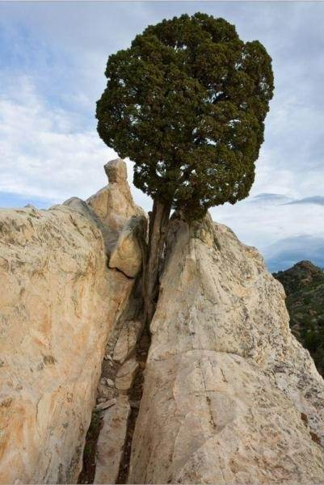
What is this an example of?

Slide 30
Mechanical Weathering – Plants

Slide 31
This type of weathering breaks down rocks by changing the chemical compostion

Slide 32
Chemical Weathering

Slide 33
Running water, Wind, Gravity and Ice are the agents of….

Slide 34
Erosion

Slide 35
When rocks or sand scrape against each other, causing them to weather away is……..

Slide 36
Abrasion

Slide 37
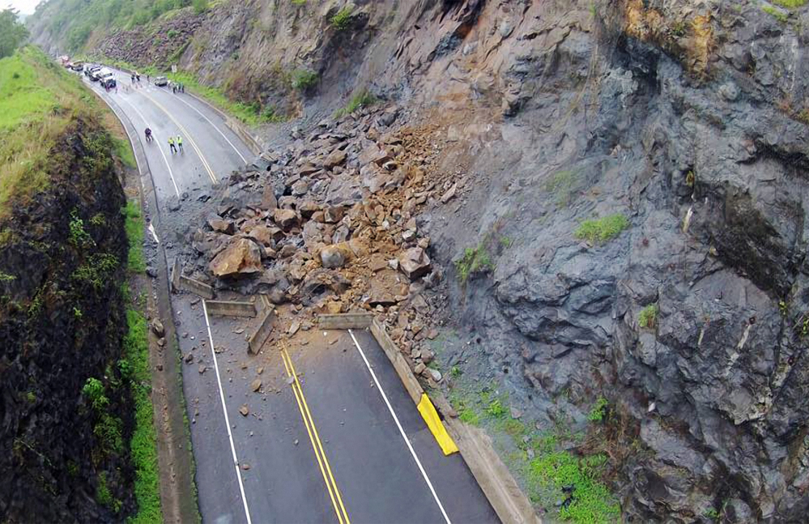
What is this an example of?

Slide 38
Mechanical Weathering - Gravity

Slide 39
Where will a bike rust faster, a dry cold climate or a humid warm one?

Slide 40
Humid and Warm Climate

Slide 41
When an agent of erosion loses energy, this process occurs….

Slide 42
Deposition

Slide 43
How do Lichen break down rocks?

Slide 44
Chemical Weathering – Acid in Living Things

