Slide 1
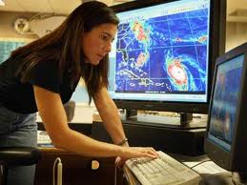
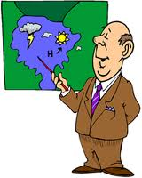
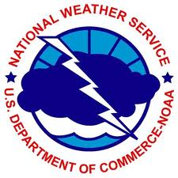
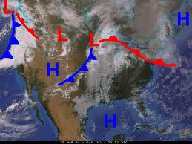
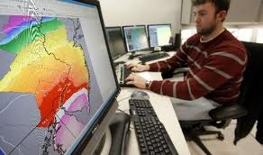
METEOROLOGY
The study of phenomena in the atmosphere such as weather.

Slide 2
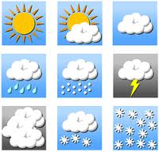
WEATHER
The condition of the atmosphere at a particular time and location.

Slide 3
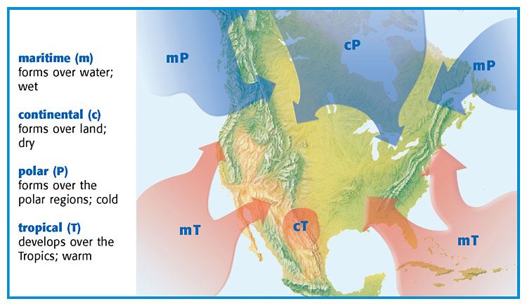
Changes in weather are caused by the movement and interaction of air masses. An AIR MASS is a large body of air where temperature and moisture content are similar throughout.

Slide 4
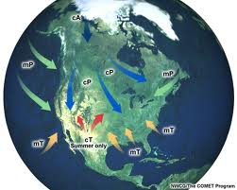
COLD AIR MASSES
Most of the cold winter weather in the United States is influenced by three polar air masses. A continental polar (cP) air mass forms over northern Canada, which brings extremely cold winter weather to the United States. In the summer, a cP air mass generally brings cool, dry weather.
A maritime polar (mP) air mass that forms over the North Pacific Ocean is cool and very wet. This air mass brings rain and snow to the Pacific Coast in the winter and cool, foggy weather in the summer.
A maritime polar air mass that forms over the North Atlantic Ocean brings cool, cloudy weather and precipitation to New England in the winter.

Slide 5
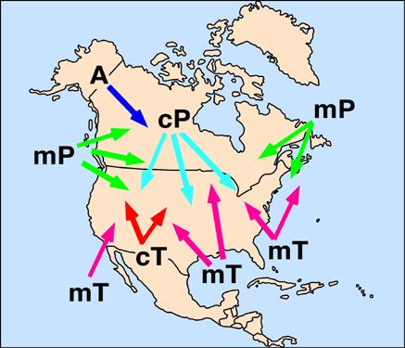
WARM AIR MASSES
Four warm air masses influence the weather in the United States. A maritime tropical (mT) air mass that develops over warm areas in the Pacific Ocean and
other maritime tropical air masses develop over the warm waters of the Gulf of Mexico and the Atlantic Ocean. These air masses move north across the East Coast and into the Midwest. In the summer, they bring hot and humid weather, hurricanes, and thunderstorms. In the winter, they bring mild, often cloudy weather. A continental tropical (cT) air mass forms over the deserts of northern Mexico and the southwestern United States. This air mass moves northward and brings clear, dry, and hot weather in the summer.

Slide 6
FRONTS
The Area Where Two Types of Air Masses Meet

Slide 7
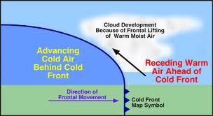
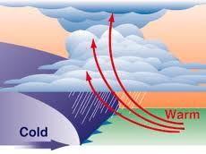
COLD FRONT
A cold front forms where cold air moves under warm air, which is less dense, and pushes the warm air up. Cold fronts can move quickly and bring thunderstorms, heavy rain, or snow. Cooler weather usually follows a cold front because the air mass behind the cold front is cooler and drier than the air mass that it is replacing.

Slide 8
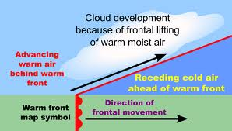
WARM FRONT
A warm front forms where warm air moves over cold, denser air. In a warm front, the warm air gradually replaces the cold air. Warm fronts generally bring drizzly rain and are followed by clear and warm weather.

Slide 9
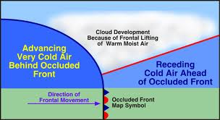
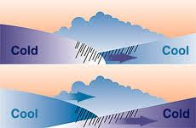
OCCLUDED FRONT
An occluded front forms when a warm air mass is caught between two colder air masses. The coldest air mass moves under and pushes up the warm air mass. The coldest air mass then moves forward until it meets a cold air mass that is warmer and less dense. The colder of these two air masses moves under and pushes up the warmer air mass. An occluded front has cool temperatures and large amounts of rain and snow.

Slide 10
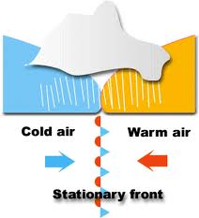
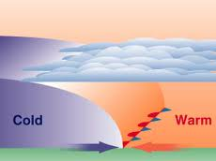
STATIONARY FRONT
A stationary front forms when a cold air mass meets a warm air mass. In this case, however, both air masses do not have enough force to lift the warm air mass over the cold air mass. So, the two air masses remain separated. This may happen because there is not enough wind to keep the air masses pushing against each other. A stationary front often brings many days of cloudy, wet weather.

Slide 11
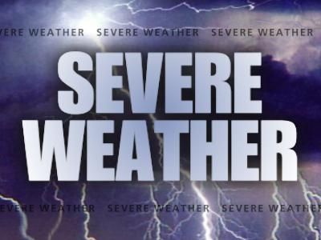
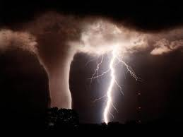
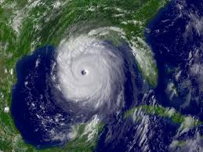
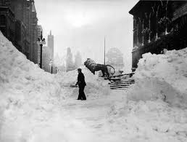

Slide 12
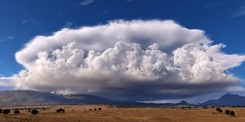
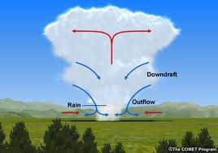
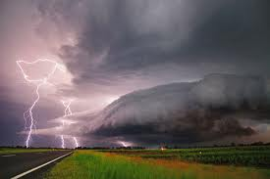
THUNDERSTORM
Small, intense weather systems that produce strong winds, heavy rain, lightning, and thunder. Thunderstorms can occur along cold fronts. There are only two atmospheric conditions required to produce thunderstorms: warm and moist air near Earth’s surface and an unstable atmosphere. The atmosphere is unstable when the surrounding air is colder than the rising air mass.

Slide 13
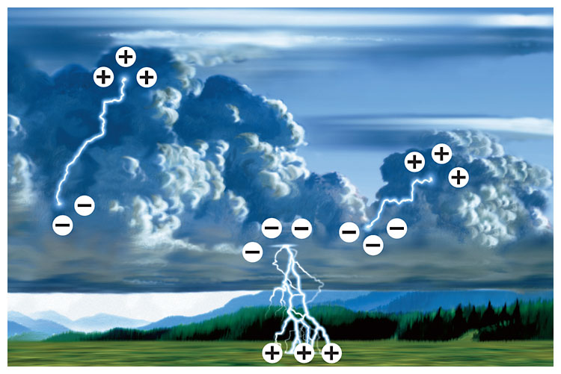
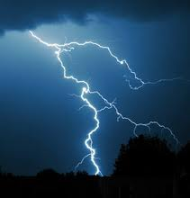
LIGHTNING
An electric discharge that occurs between a positively charged area and a negatively charged area. Lightning can happen between two clouds, between Earth and a cloud, or even between two parts of the same cloud. Have you ever touched someone after scuffing your feet on the carpet and received a mild shock? If so, you have experienced how lightning forms. While you walk around, friction between the floor and your shoes builds up an electric charge in your body. When you touch someone else, the charge is released.

Slide 14
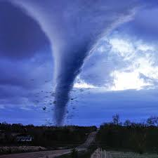
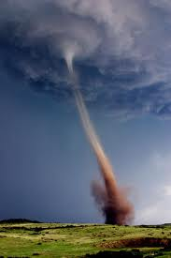
TORNADO
Tornadoes happen in only 1% of all thunderstorms. A tornado is a small, spinning column of air that has high wind speeds and low central pressure and that touches the ground. A tornado starts out as a funnel cloud that pokes through the bottom of a cumulonimbus cloud and hangs in the air. The funnel cloud becomes a tornado when it makes contact with Earth’s surface.

Slide 15
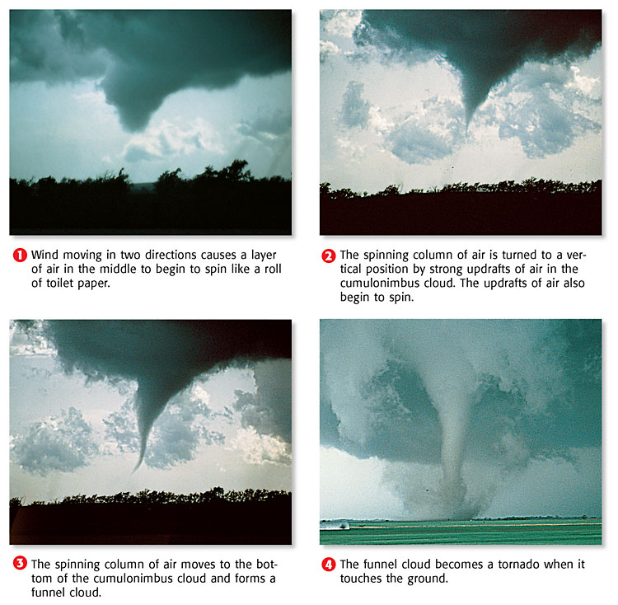
How A Tornado Forms

Slide 16
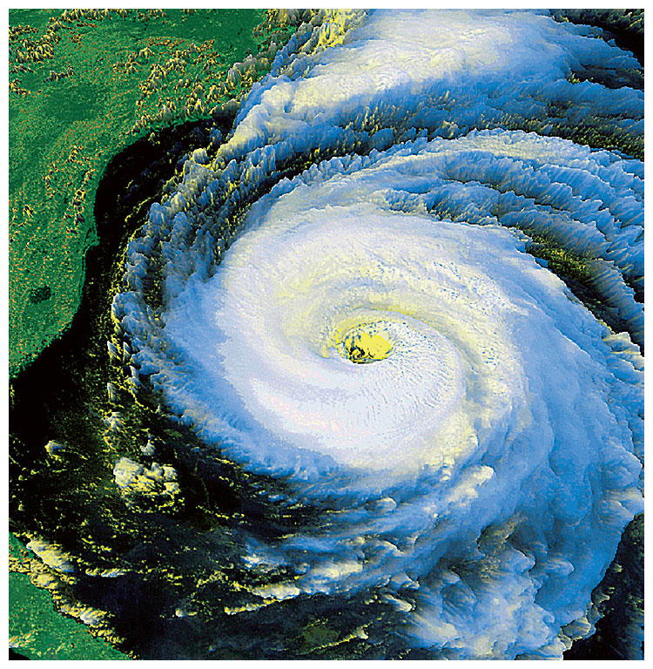
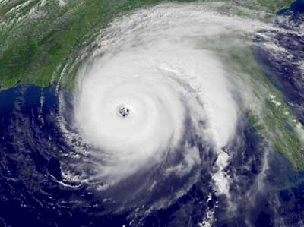
HURRICANE
A large, rotating tropical weather system that has wind speeds of at least 120 km/h is called a hurricane. Hurricanes are the most powerful storms on Earth. Hurricanes have different names in different parts of the world. In the western Pacific Ocean, hurricanes are called typhoons. Hurricanes that form over the Indian Ocean are called cyclones.

Slide 17
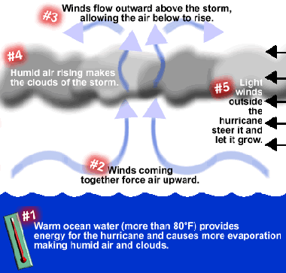
How A Hurricane Forms

Slide 18
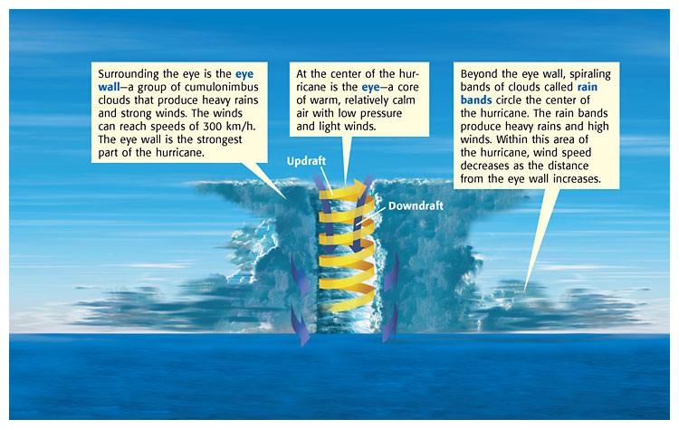
A HURRICANE begins as a group of thunderstorms moving over tropical ocean waters. Winds traveling in two different directions meet and cause the storm to spin. A hurricane gets its energy from the condensation of water vapor. Once formed, the hurricane is fueled through contact with the warm ocean water. The hurricane continues to grow as long as it is over its source of warm, moist air. When the hurricane moves into colder waters or over land, it begins to die because it has lost its source of energy.

Slide 19
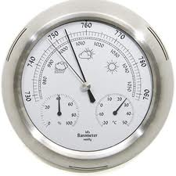
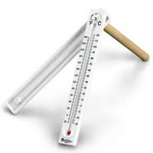
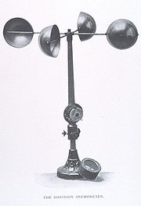
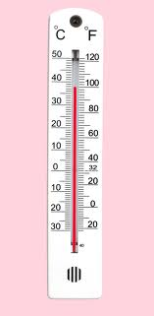
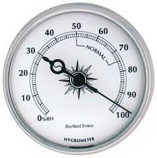
Tools for Measuring The Weather
A Barometer Measures Air Pressure
A Psychrometer Measures Relative Humidity
An Anemometer Measures Wind Direction
A Thermometer
Measures the
Temperature
A Hygrometer Measures Humidity.

Slide 20
VIDEO LINKS
http://studyjams.scholastic.com/studyjams/jams/science/weather-and-climate/weather-and-climate.htm
http://video.nationalgeographic.com/video/science/earth-sci/climate-weather-sci/
http://studyjams.scholastic.com/studyjams/jams/science/weather-and-climate/earths-atmosphere.htm
http://video.nationalgeographic.com/video/science/space-sci/solar-system/sun-101-sci/
http://studyjams.scholastic.com/studyjams/jams/science/weather-and-climate/air-masses-and-fronts.htm
http://video.nationalgeographic.com/video/science/earth-sci/weather-101-sci/
http://video.nationalgeographic.com/video/environment/environment-natural-disasters/tornadoes/tornadoes-101/
http://video.nationalgeographic.com/video/kids/forces-of-nature-kids/hurricanes-101-kids/
http://video.nationalgeographic.com/video/environment/environment-natural-disasters/hurricanes/katrina-formation/

