Slide 1
Be Great…. Be Griffin….
Notes:
At Griffin we are family; therefore, we treat each other and our environment with respect. We may disagree, but we will still respect each other’s opinions.
What is something about Griffin that you like or makes you proud?

Slide 2
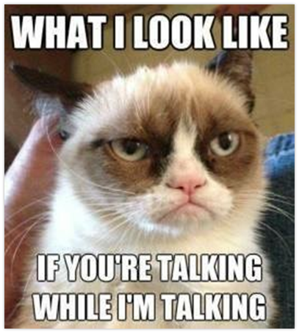
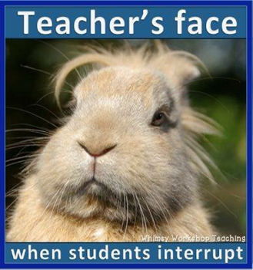
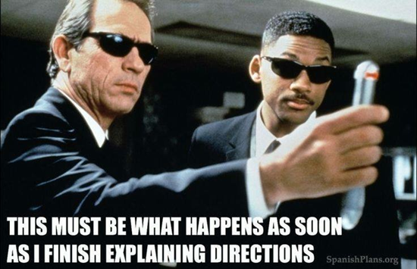
Be Respectful...
Seriously, do I need to explain more?

Slide 3
What does being respectful look like?
Please don’t talk while I am talking. Raise your to be called upon.
Keep hands and feet to yourself.
Listen to instruction the first time it is given.
Please do not argue with teacher.
Be ON TIME – Tardy is late and a distraction!
Opinions and ideas are welcome ☺

Slide 4
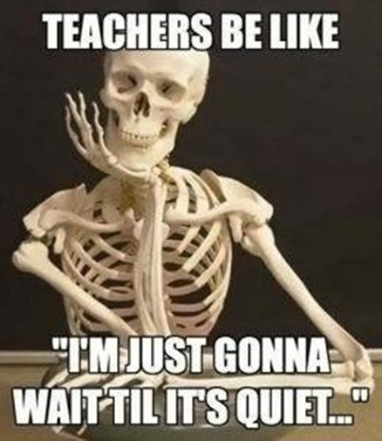
Silence is a virtue...
I will ring the bell and raise my hand and ask you to give me five.
I will count down from 5-1.
By the time I get to 1, I will expect you to be SILENT.

Slide 5
How will I get your attention?
I will ring the bell and raise my hand and ask you to give me five.
I will count down from 5-1.
By the time I get to 1, I will expect you to be SILENT.

Slide 6
Be On Time...be prepared...
Everyday you will need something to write with, your notebook, and your agenda.
NEVER leave home without it!

Slide 7
What does being prepared look like?
Come to class with:
NOTEBOOK – EVERYDAY
Something to write with.
Blank notebook paper
ALL homework and science folder (2 pocket)

Slide 8
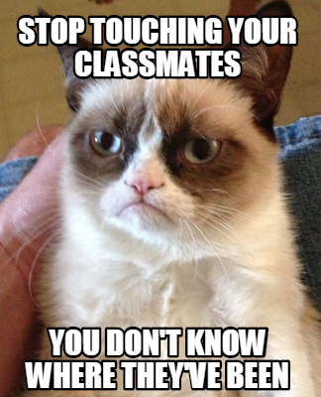
Keep yourself to yourself...

Slide 9
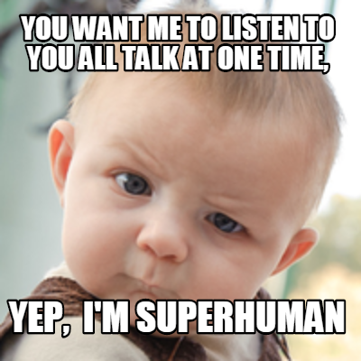
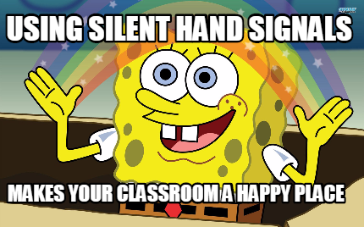
Raise your hand for permission...

Slide 10
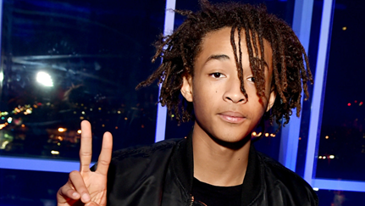
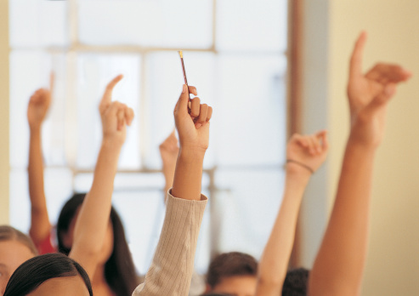
Speak loudly...but silently!...
Two fingers for "I need a tissue"
Raise your hand to ask a question
Three fingers for "I need to use the restroom"
Raise a one finger to ask to sharpen

Slide 11
What are silent hand signals?
Raise your hand for permission to speak or move around the room.
Raise 1 finger to ask to sharpen a pencil. Wait for a break in instruction before you sharpen.
Raise 2 fingers to ask for a tissue.
Raise 4 fingers to ask to get water.
Cross your fingers and raise them in the air to ask to use the restroom.
Raise your hand to ask a question.

Slide 12
Is it ok to get up and walk around the room at any time?

Slide 13
Table Positions
A – Paper Collector: quietly collect all papers from table and put in correct color bin
B –Material Retriever: gets materials for class activity
C – Table Monitor: Guide discussions and keep to keep conversations on topic
D – Return Materials: collect materials from table, place back in correct location

Slide 14
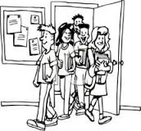
How to enter the classroom
Line up outside the door and stand against wall.
When the door is open, come in quietly, get out materials, and begin warm – up
If materials are needed, the Materials Manager will get materials.
If papers need to be collected, the Paper Collector will get papers and turn them in to the correct bin.

Slide 15
Noise levels
Level 3 – work in groups (3-6 people)
Can be heard by everyone at your table
Level 2 – work in partners
Can only be heard by your partner
Level 1 – Whisper
Can be heard by someone very close to you
Level 0 – NO NOISE
Used during testing, walking in line or when others are talking.

Slide 16
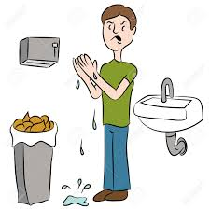
Bathroom expectations
Use your inside voice.
Respect others’ privacy and school property.
Keep your hands, feet and objects to YOURSELF.
Keep phones/electronics and headphones put away.
Flush toilet and wash your hands.

Slide 17
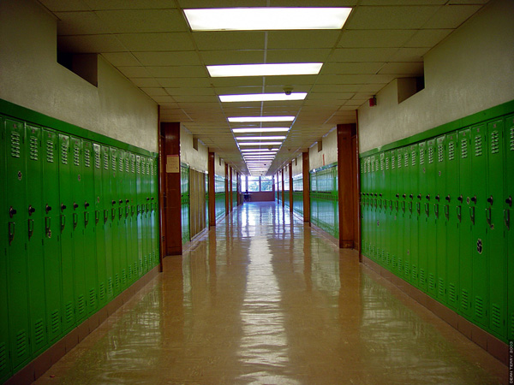
Hallway expectations
Keep your hands, feet and objects to yourself.
Walk on right side of the hallway directly to your destination.
When walking in a LINE, walk single filed 2 squares from the wall.
Keep phones/electronics and headphones put away.
SILENT voices during transitions with teacher.
Use inside voice during all transitions.

Slide 18
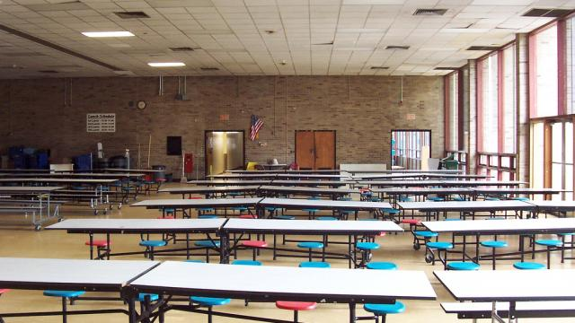
Cafeteria expectations
Use your inside voice only
Keep hands, feet, objects, and food to yourself.
Go to your assigned table / get permission before leaving your seat.
Clean up your area before you leave

Slide 19
How to exit the classroom
Stay in seat until dismissed
Collect all personal belongings and take them with you
- All found belongings will be placed in the classroom
‘Lost and Found’
- If not claimed, it will be donated.
Pick up at least 3 piece of trash off the floor.
Quietly exit out EXIT door only

Slide 20
What is PBIS?
Reward system allowing you to earn points for good behavior – Cool Cat Points
Positive
Behavioral
Interventions and
Support

Slide 21
To Earn Cool Cat Points….
Be HERE
Be READY
Be RESPECTFUL

Slide 22
Be Here
Attend school every day
Get to class on time
Be present (actively participating) in class

Slide 23
Be Ready
Complete all assignments
Meet deadlines
Follow school and classroom expectations
Be prepared for class
Put belongings in proper places

Slide 24
Be Respectful
Helping others
Ignoring improper behavior
Caring for personal and school property
Cleaning up after yourself

