Slide 1
Thankful Thursday 8/8/19☺
Mrs. Kimble and Mr. Brown
6th Grade Earth Science
Homeroom: Take out agenda and ALL forms that need to be returned. Remember I need ALL forms in order for you to receive a locker!
*Clinic Card
*Family Information Guide
*PBIS Form
Notes:
Faded background picture
(Basic)
To reproduce the background effects on this slide, do the following:
On the Home tab, in the Slides group, click Layout and then click Blank.
Right-click the slide and click Format Background.
In the Format Background dialog box, click Fill in the left pane. In the Fill pane, select Picture or texture fill, and then under Insert from, click File.
In the Insert Picture dialog box, select a picture, and then click Insert.
Also in the Format Background dialog box, in the Fill pane, in the Transparency box, enter 85%.

Slide 2
Thankful Thursday 8/8/19☺
Mrs. Kimble and Mr. Brown
6th Grade Earth Science
****Thankful Thursday 8/8/19 Schedule****
Homeroom: 8:50am-9:40am
1st period: 9:43am-11:11am
2nd period: 11:14am-1:10pm
3rd period: 1:13-2:41pm
6th period: 2:45pm-3:28pm
7th period: 3:32-4:15pm
Notes:
Faded background picture
(Basic)
To reproduce the background effects on this slide, do the following:
On the Home tab, in the Slides group, click Layout and then click Blank.
Right-click the slide and click Format Background.
In the Format Background dialog box, click Fill in the left pane. In the Fill pane, select Picture or texture fill, and then under Insert from, click File.
In the Insert Picture dialog box, select a picture, and then click Insert.
Also in the Format Background dialog box, in the Fill pane, in the Transparency box, enter 85%.

Slide 3
Thankful Thursday 8/8/2019
Success Starter: Come in QUIETLY, take out agenda, and science binder
Opening: The Hunt is ON!!!!!!!! (15 MINUTES)
Work Session: Procedure notes
Closing: Model expectations

Slide 4
Thankful Thursday 8/8/2019
Success Starter: Come in QUIETLY, take out agenda, and science binder. Discuss syllabus. **Due on Monday (8/12)**
Make sure you write your name on and in science binder. If you have your science folder, write your name on your science folder.
*5 minutes*

Slide 5
Thankful Thursday 8/8/2019
Opening: The Hunt is ON!!!!!!!! (15 MINUTES)
You have 15 minutes to complete your classroom and textbook hunt! Once the timer goes off, return to your seat. You will have an additional 15 minutes to complete your 2nd scavenger hunt! 1 RULE: Can NOT ask teachers for help☺
GOOD LUCK!!!!!!!!!

Slide 6
Thankful Thursday 8/8/2019
Work Session: Begin classroom procedure notes
Place your Classroom Expectation Notes in the front of your science binder. Make sure you pay attention!!!! We will have a Classroom Expectation Quiz on Monday (8/12) and Tuesday(8/13).

Slide 7
Thankful Thursday 8/8/2019
Closing: Get to know me questions

Slide 8
What will we learn in Earth Science?

Slide 9
What will we learn in Earth Science?
Solar system
Earth & moon
Weather systems
Water on earth
Earth’s composition
Rocks and minerals
Weathering, erosion, soil
Energy and conservation

Slide 10
Procedure Notes!

Slide 11
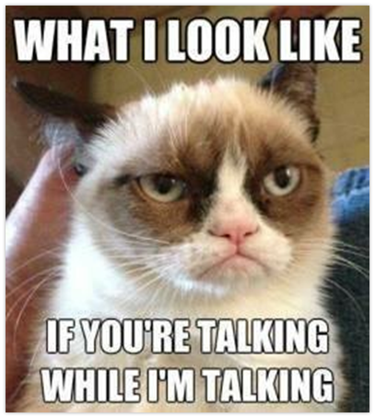
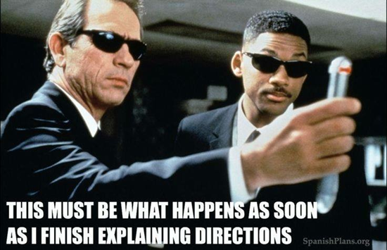
Be Respectful...
Seriously, do I need to explain more?

Slide 12
Be Ready: On Time...be prepared...
Everyday you will need something to write with, notebook paper, and your science binder.
NEVER leave home without it!

Slide 13
What are the classroom expectations?
Please don’t talk while we are talking.
Raise your hand to be called upon.
Keep hands and feet to yourself.
Listen to instruction the first time it is given.
Please do not argue with teacher.
Be ON TIME – Tardy is late and a distraction!
Opinions and ideas are welcome ☺

Slide 14
How will I get your attention?
We will count down from 5 .
By the time we get to 1, we will expect you to be silent, stop moving and have eyes on me.

Slide 15
What does being prepared look like?
Come to class with:
Your science binder EVERYDAY
A pencil to write with.

Slide 16
What are my silent hand signals?
Raise your hand for permission to speak or move around the room.
Raise your 1 finger to ask to sharpen pencil. Wait for permission before sharpening.
Never use the electric pencil sharpener when someone is speaking to the class, student or teacher.
Cross your fingers to ask to use the restroom.

Slide 17
Moving around the room
Is it okay to move around the room?
Silent hand signals or hands raised will let me know what you need.

Slide 18
Pencils
You may silently sharpen pencils during the successful starter
No more than 2 people at the sharpener at one time
During lessons and activities if you need to sharpen your pencil hold your finger in the air and wait for approval
If you need to borrow a pencil use hand signal and ask classmate
Do not sharpen pencils while the teacher or students are talking!

Slide 19
Glue
Glue stick: make a line on the perimeter of the paper to glue in, roll down glue before capping, place dried or empty glue sticks in team trash can
Glue bottles: place one dot of glue on each corner of the worksheet to glue in, make sure top is twisted shut

Slide 20
Table Positions
A – Material Retriever: gets materials from class period drawer
B – Paper Collector: quietly collect all papers from table and put in correct color bin
C – Return Materials: collect materials from table, place back in class period drawer
D – Communicator: collaborate with table, speak for table when a question is asked to table.

Slide 21
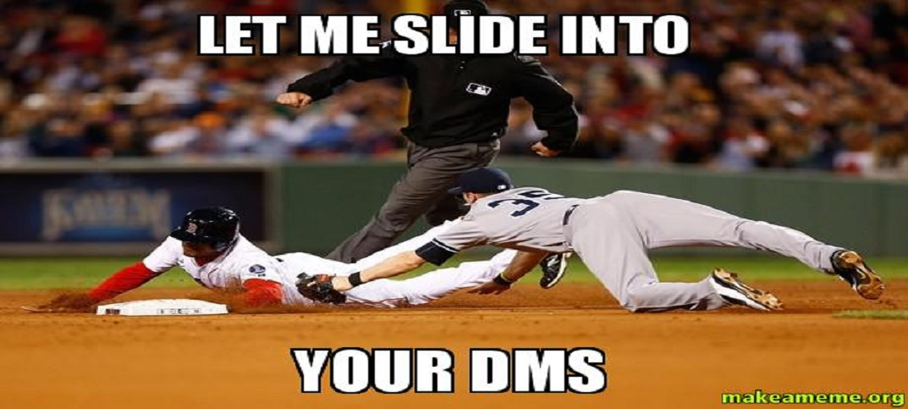
DMs Bin
Mrs. Kimble and Mr. Brown has a DM bin. This bin is purple and located by Sky’s tank. Any messages, concerns (inside and/or outside of the classroom), and questions you may have regarding science. Make sure you put your 1st and last name on message and period.

Slide 22
The Teacher Assistant(T.A.)
Helps Mrs. Kimble and Mr. Brown with collecting papers and all materials
Assist with “managing” the class; will be given respect!!!!
Helps teach classmates and students who were absent
Responsible for helping substitute when Mr. Gunn and/or Ms. Brown is absent
Responsible for making sure the class is running smoothly

Slide 23
Paper Headings
Always write your first and last name, date, class period, and page number in your science binder, and title of activity
If you are doing several activities in your binder you need a title for each activity.

Slide 24
Turning in binders
The paper collector will collect all four binders and place them inside the bin.

Slide 25
Absent
Check team blog
Check ketchup folder to find worksheets we worked on in class and place them inside your science folder.

Slide 26
Late Work
Policy: 5 points deducted each day
Turn in notebook on the assigned bookshelf to leave for me to grade
Make sure you turn in assignment in your class period late work bin.

Slide 27
Group Folders
The first student to enter the room will pass out all of the group folders SILENTLY, then sit down and begin the success starter

Slide 28
Putting Away Group Folders
Resource monitors or one volunteer picked by the teacher will put away the group folders after they finish the closing activity
Place folders in numerical order in their correct bin

Slide 29
Teacher’s Desk
You should never be by my desk or behind the tape
Never place papers on my desk

Slide 30
Success Starter/Entering the Room
Enter silently
Use an efficient route to find your seat
Begin the success starter on a new page in your science binder on the left page

Slide 31
Voice Levels
0-3
Level 3: Your voice can be heard by the entire class. We are having a whole group discussion.
Level 2: You and your table mates are having a discussion in your group. Voice is heard ONLY by teammates at table.
Level 1: At this level, your voice is heard only by the person sitting next to you. Voice is at a whisper level.
Level 0 : At this level, ALL mouths are closed. The room is silent.

Slide 32
Tardy
Fill out tardy clipboard
Put pass in classroom inbox.
If pass is in agenda, leave agenda face up on desk for me to walk by and check

Slide 33
Bathroom Expectations
Use your inside voice.
Respect others’ privacy and school property.
Keep your hands, feet and objects to YOURSELF.
Keep phones/electronics and headphones put away.
Flush toilet and wash your hands.

Slide 34
Bathroom Passes
Use hand signal to notify me that you need to use the restroom
If approved, fill out the bathroom sign in/out log and take your agenda

Slide 35
Hallway Expectations
Keep your hands, feet and objects to yourself
Walk on right side of the hallway directly to your destination.
When walking in a LINE, walk single filed 2 squares from the wall.
Keep phones/electronics and headphones put away.
SILENT voices during transitions with teacher.
Use inside voice during all transitions.

Slide 36
Hallway Lines
Line leader: Leads line in hallways
Line captain: Patrols our line to make sure hallway procedure is ensured

Slide 37
Cafeteria Expectations
Use your inside voice only
Keep hands, feet, objects, and food to yourself.
Go to your assigned table / get permission before leaving your seat.
Clean up your area before you leave
You may NOT use your phone during lunch
- No headphone or phone use in the hallway
- No pictures, Snapchat, or texting other students

Slide 38
How to exit the classroom:
I will announce by table once groups have their materials put away and accounted for
Line up along counters silently by exit door

Slide 39
PBIS Cool Cat Points
Reward system allowing you to earn points for good behavior
Purchase cool stuff with cool cat points
Pencils, candy, special recognition, popcorn, chips

Slide 40
Our Classroom Rules:
L.E.A.R.N.
L- listen to instruction 1st time given
E- enter and exit classroom quietly
A-always prepared
R-Respecting yourself and others
N- never giving up!!!!!!!!!
Notes:
Faded background picture
(Basic)
To reproduce the background effects on this slide, do the following:
On the Home tab, in the Slides group, click Layout and then click Blank.
Right-click the slide and click Format Background.
In the Format Background dialog box, click Fill in the left pane. In the Fill pane, select Picture or texture fill, and then under Insert from, click File.
In the Insert Picture dialog box, select a picture, and then click Insert.
Also in the Format Background dialog box, in the Fill pane, in the Transparency box, enter 85%.

Slide 41
Grading
Summative: Tests, Projects, Labs | 30%
Formative: Classwork, warm-ups, reflections, notes, homework | 70%
A | 90-100%
B | 80-89%
C | 74-79%
D | 70-73%
F | 69% and below

