Slide 1
Distribution of water

Slide 2
Water Cycle
The water cycle is the movement of water between the atmosphere, land, ocean and living things.
Due to the constant movement of water, the amount of water on earth has remained the same for millions of years.
How are evaporation and transpiration related to the movement of underground water?

Slide 3
Water cycle diagram

Slide 4
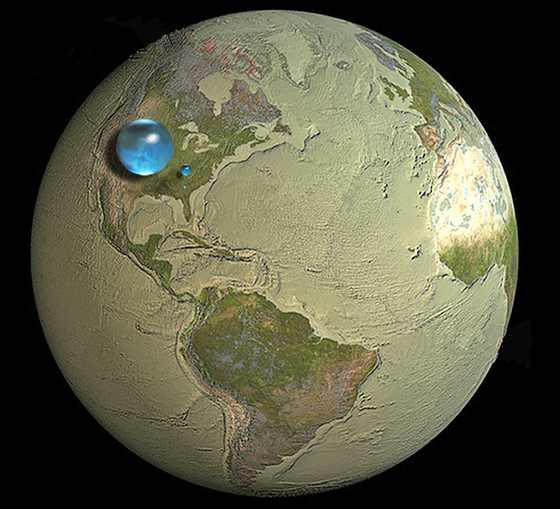
The blue spheres represent the relative amounts of Earth's water in comparison to the size of the Earth.
Are you surprised that these water spheres look so small? They are only small in relation to the size of the Earth.
Overall, it shows that in comparison to the volume of the globe the amount of water on the planet is very small.
Notes:
Instructional Approach(s): The teacher should present the information on the slide.

Slide 5
The largest sphere represents all of Earth's water.
The sphere includes all the water in the oceans, ice caps, lakes, and rivers, as well as groundwater, atmospheric water, and even the water in you, your dog, and your tomato plant.
Notes:
Instructional Approach(s): The teacher should present the information on the slide.

Slide 6
How much of the total water is fresh water, which people and many other life forms need to survive?
The blue sphere over Kentucky represents the world's liquid fresh water (groundwater, lakes, swamp water, and rivers).
Notes:
Instructional Approach(s): The teacher should present the information on the slide.

Slide 7
Do you see the "tiny" bubble over Atlanta, Georgia?
That one represents fresh water in all the lakes and rivers on the planet.
Most of the water people and life on earth need every day comes from these surface-water sources.
Notes:
Instructional Approach(s): The teacher should present the information on the slide.

Slide 8
Water on the Earth
About 71% of the earth’s surface is covered with water.
Of the total volume of water on Earth:
97% is saltwater
2% is freshwater frozen in ice caps and glaciers
1% is fresh water in lakes and streams, groundwater, and water vapor in the atmosphere
In general, most of the earth’s water is located in the oceans as saltwater. Most of the freshwater on Earth is located in glaciers and ice caps. Lesser amounts are found in atmospheric moisture, rivers, lakes, streams, and groundwater.
Most of the freshwater on Earth is located in glaciers and ice caps.
Notes:
Instructional Approach(s): The teacher should present the information on the slide while the students record the important information on their notes.

Slide 9
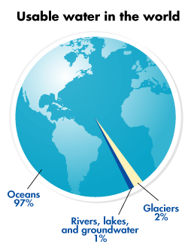
Water of the World
Notes:
Instructional Approach(s): The teacher should use the graph on the slide to illustrate the amount of usable water in the world.

Slide 10
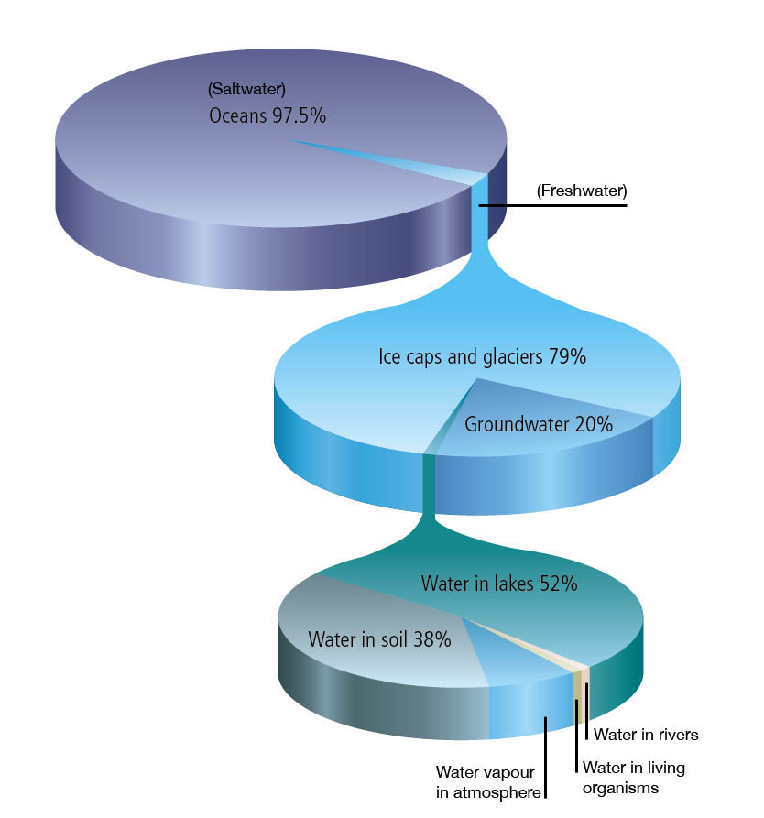
This pie chart represents all the water on earth:
97.5% saltwater
2.5% freshwater
This pie chart represents all the fresh water on earth:
79% ice caps and glaciers
20% groundwater
1% AVAILABLE water
Most available water is located in rivers and streams
This pie chart represents all the available water on earth
Notes:
Instructional Approach(s): The teacher should use the graph on the slide to illustrate the amount and types of water on the earth.

Slide 11
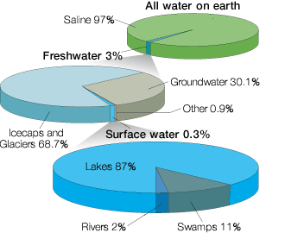
Most available water is located in rivers and streams
Notes:
Instructional Approach(s): The teacher should use the graph on the slide to illustrate the amount and types of water on the earth.

Slide 12
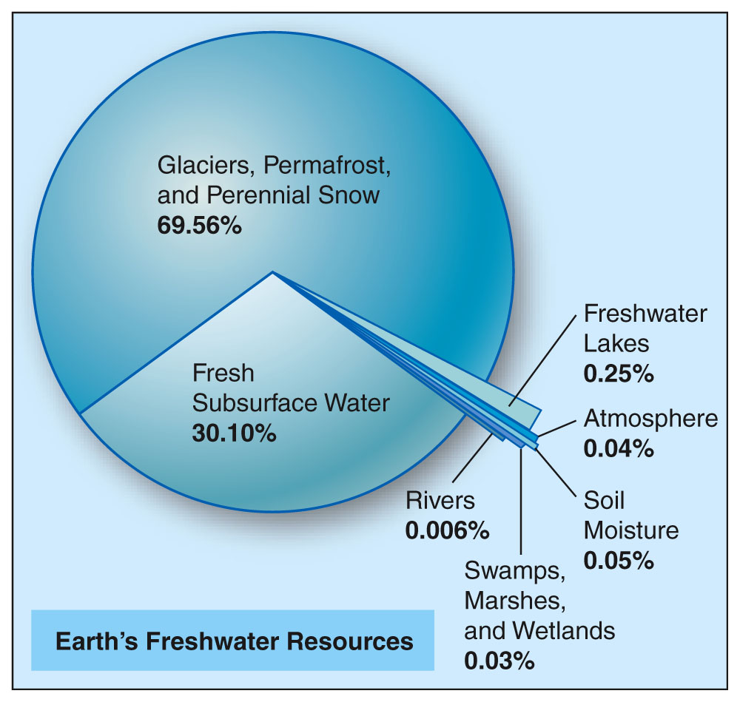
Most available water is located in rivers and streams
Notes:
Instructional Approach(s): The teacher should use the graph on the slide to illustrate the amount and types of water on the earth.

Slide 13
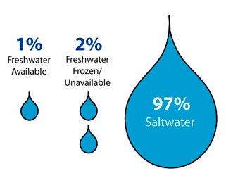
Notes:
Instructional Approach(s): The teacher should present the information on the slide while the students record the important information on their notes.

Slide 14
Water on the Earth
Water is not evenly distributed, and most of it is unsuitable for drinking.
We use less than 1% of the water on Earth for drinking and personal hygiene. We also use this fresh water for agriculture, fisheries, transportation, heating and cooling, manufacturing, and many other purposes.
Unless we use our freshwater supply wisely, rivers, lakes and groundwater can be depleted or polluted, becoming unusable or unsuitable for life.
Notes:
Instructional Approach(s): The teacher should present the information on the slide while the students record the important information on their notes.

Slide 15
Label the following images as representations of which of the following: Glaciers/Icecaps, Groundwater, Lakes/Rivers, Saltwater on Earth
Notes:
Instructional Approach(s): The students should label the images on their notes as representations of the amounts/types of water on the earth’s surface. The teacher should walk around monitoring and redirecting students as needed. Do not give more than 1 minute for students to label the representations. The teacher should ask students to compare their responses with another student. Go over the answers with the class.

