Slide 1
Scavenger Hunt
This has been a fun year for all of us and we are so sad that it had to be cut short.
You know one of our biggest goals is for you to see Earth Science in the world around you. This is your opportunity to show off.
On the pages that follow, you will find a topic. Your goal is to insert a picture that illustrates that topic.
A picture YOU TAKE is encouraged. However, if you HAVE to use internet pictures, that is ok.
Download and save this PPT.
When you are done, email the edited version to your teacher.
Have Fun!
This Photo by Unknown Author is licensed under CC BY-SA-NC

Slide 2
Moon Phase
Place picture here
What is the moon phase?
___________________________

Slide 3
atmosphere
Take a picture of an item in the troposphere.

Slide 4
Water Cycle
Place picture here
Take a picture that illustrates as many processes as you can of the water cycle.
*** Bonus: label the processes

Slide 5
Weather
Describe what kind of weather we are having. Include:
Type of front
And / Or
High or Low pressure system
Place picture that corresponds with your description here.

Slide 6
Water
Find a place where there is water.
Identify if they water is runoff, drainage, accumulation…..

Slide 7
Erosion
We have learned that there are different types of erosion.
Find erosion and label the type of erosion.

Slide 8
Weathering
Find an example of CHEMICAL WEATHERING.
Name the agent of the weathering
________________________________

Slide 9
Weathering
Find an example of MECHANICAL WEATHERING.
Name the agent of the weathering
________________________________

Slide 10
There are 3 different types of rocks igneous, sedimentary, and metamorphic.
Igneous – intrusive: cools slowly and has obvious crystals in the rocks.
extrusive: cool rapidly and has very fine crystals (often looks like glass) and sometimes air pockets.
Sedimentary – compacted and cemented sediments. Often has different colored bands called strata
Metamorphic – made by heat and pressure. Crystals are small and may not be seen. There are often is foliated ribbons

Slide 11
Igneous rock
Can you tell if it is intrusive or extrusive?
Can you name it?

Slide 12
Sedimentary rock
Can you name the rock you found?

Slide 13
Metamorphic rock
Can you name the rock you found?

Slide 14
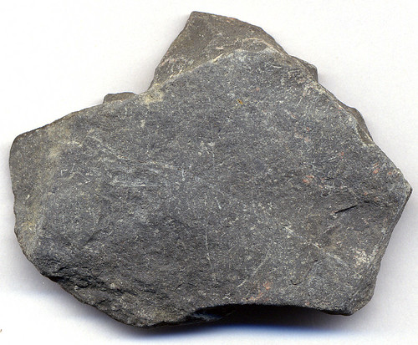
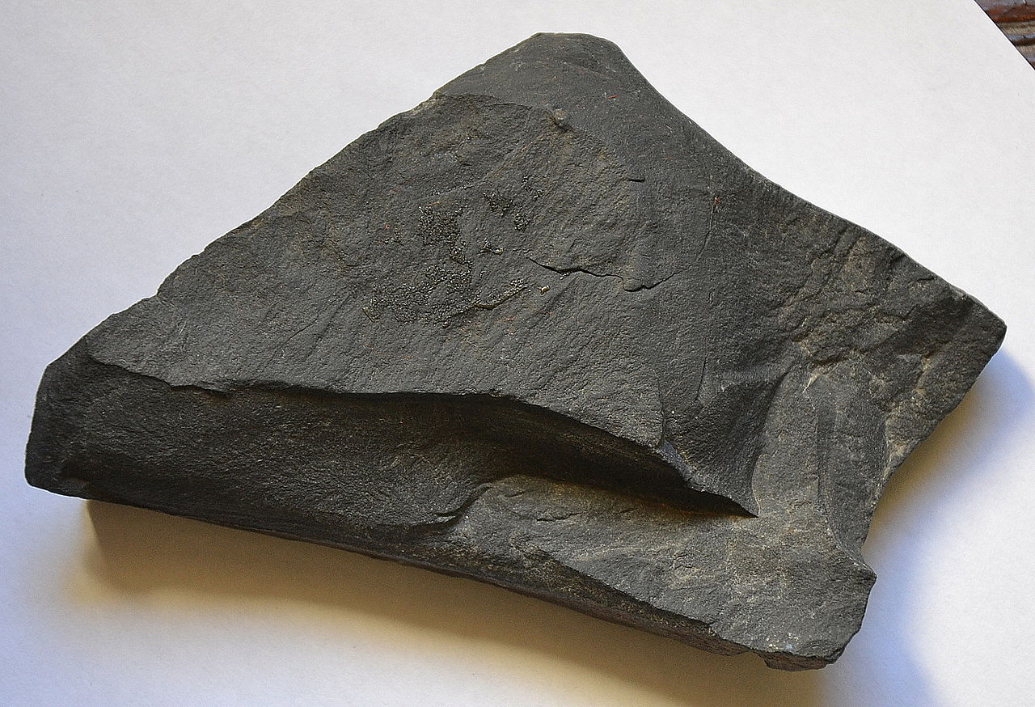
Bonus Directions Can you find and name a rock that has changed due to the rock cycle
Example parent rock: Shale
Example after heat and pressure: Slate
This Photo by Unknown Author is licensed under CC BY-SA
This Photo by Unknown Author is licensed under CC BY

Slide 15
Bounus
Parent rock:
New Rock:

