Slide 1
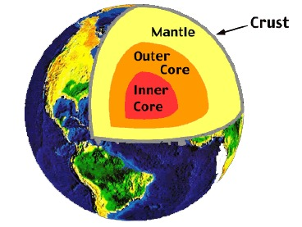
The Structure of Earth

Slide 2
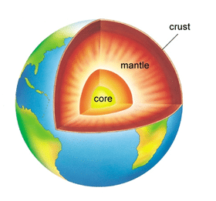
CRUST
The thinnest, outermost layer of the Earth
Only about 30 km thick
Made mostly of oxygen, silicon, and aluminum(easily broken)
Least dense layer in Earth’s geosphere
All life exists on this layer.
Consists of land and ocean.
The temperature of the crust typically varies; however the further down you dig through the crust, the temperature increases

Slide 3
MANTLE
The dense, thick layer of rock just below the crust
Earth’s thick middle layer made mostly of solid rock; makes it denser than the crust
This layer is undergoes constant heat and pressure. Temperatures range between 680°f and 4532°f
The heat and pressure causes rocks to move and bend within this layer
About 2,900 km of a thick, dense layer of rock

Slide 4
CORE
The inner most chemical layer
Made of iron and nickel, in liquid form, no water
Made up of molten lava
It is about 3,430 km thick
Temperatures typically around 3500-4300° f
Scientists know this layer is made of liquid molten lava by studying what happens when earthquakes occur

