Slide 1
Happy Monday☺ 8/20/18
Success Starter: Brain POP Video and take out agenda
Opening: If I was a 1st grader, explain the difference between expansion and explosion
Work Session: Galaxy Notes
Closing: Homework(Galaxy)

Slide 2
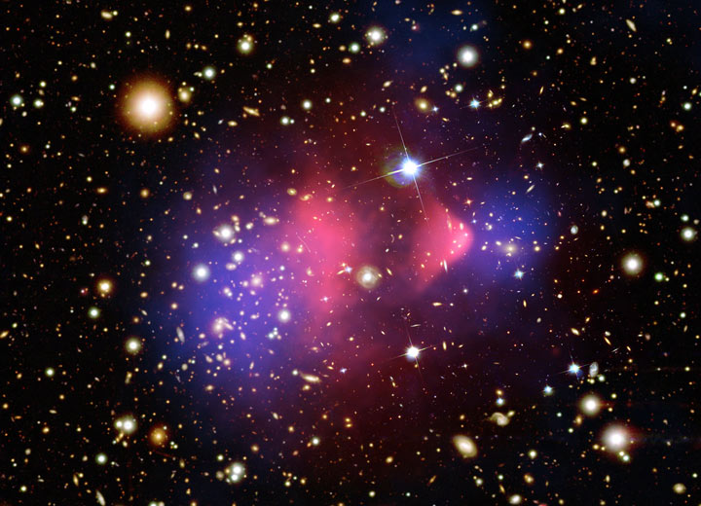
COSMOLOGY
The study of the nature of the universe.

Slide 3
Happy Monday☺ 8/20/18
Success Starter: Brain POP Video and take out agenda
https://www.brainpop.com/science/space/bigbang/

Slide 4
Happy Monday☺ 8/20/18
Opening: If I was a 1st grader, explain the difference between expansion and explosion. *Can draw a picture

Slide 5
Happy Monday☺ 8/20/18
Work Session : Glue notes in Science Notebook/ Model types of Galaxies

Slide 6
Happy Monday☺ 8/20/18
Closing: Galaxy Homework

Slide 7
COSMOLOGY
The study of the nature of the universe.

Slide 8
Study Jams “The Universe”
http://studyjams.scholastic.com/studyjams/jams/science/solar-system/universe.htm
Brain Pop “The Big Bang”
http://www.brainpop.com/science/space/bigbang/

Slide 9
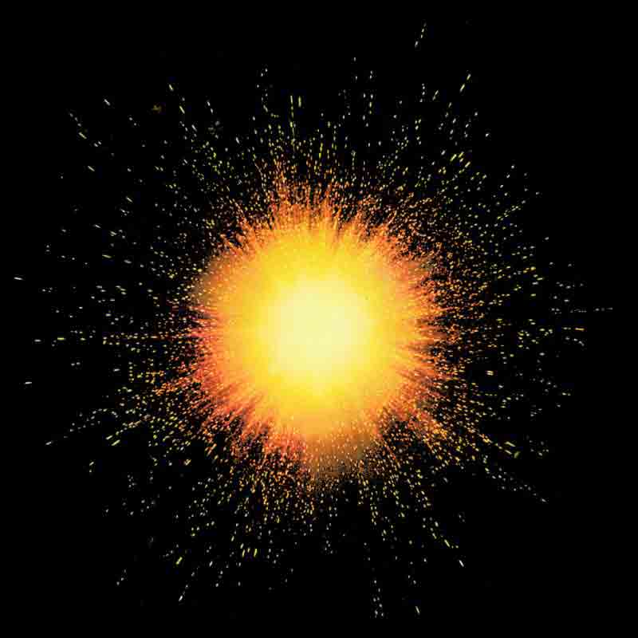
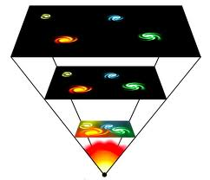
THE BIG BANG THEORY
The theory that states that the universe began about 14 billion years ago through a HUGE explosion and that the universe continues to expand even today.

Slide 10
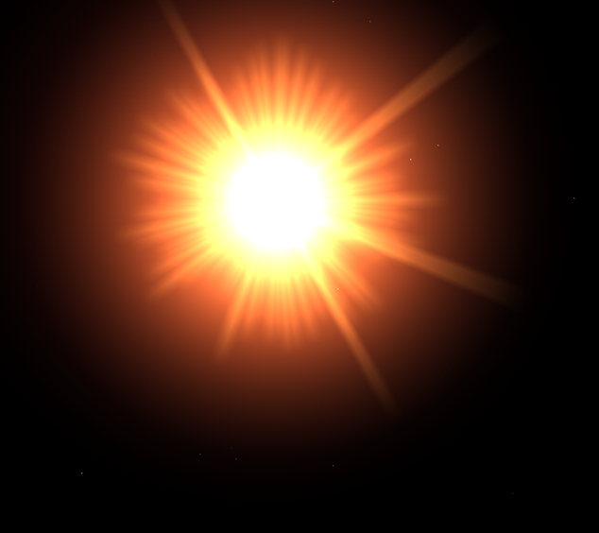
Stars Formed Next!
About 100 million years after the Big Bang, stars began to form. A star is a large ball of super hot gas that self-illuminating. (or lights up by itself)
Our Sun is a star!

Slide 11
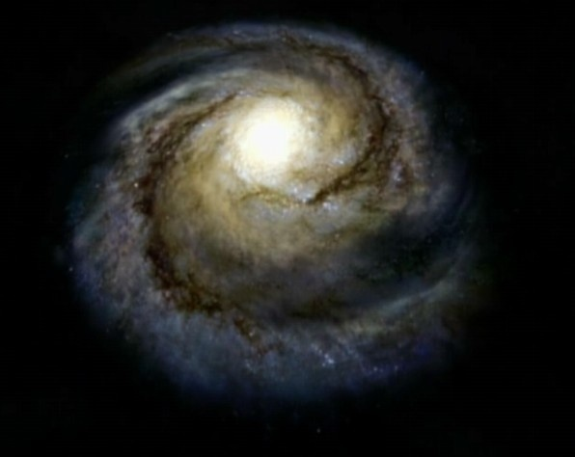
GALAXIES
Clusters of stars that group together. It is estimated that there are approximately 125 billion galaxies in the universe.

Slide 12
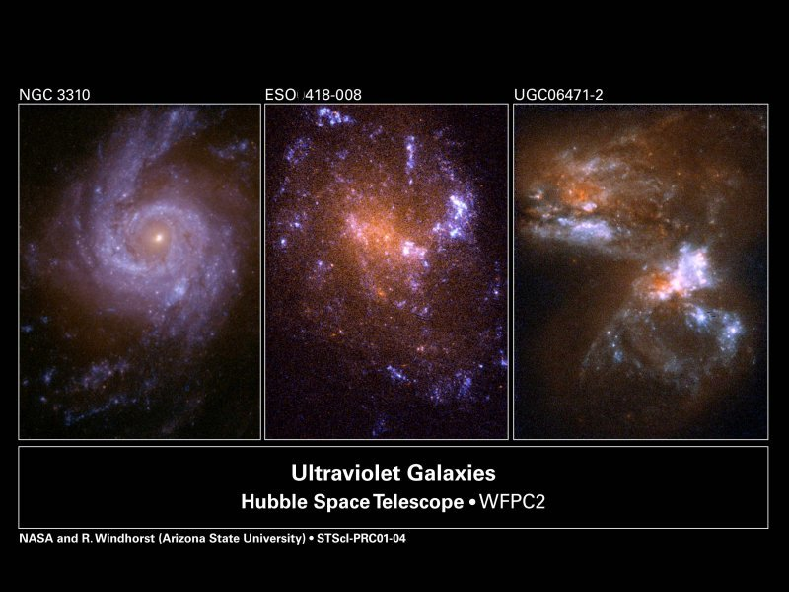
3 Shapes of Galaxies
Spiral / Disk Elliptical Irregular

Slide 13
GPS S6E1: ELEMENT “B”
Describe the position of the solar system in the Milky Way galaxy and the universe.
(Change only the red terms.)

Slide 14
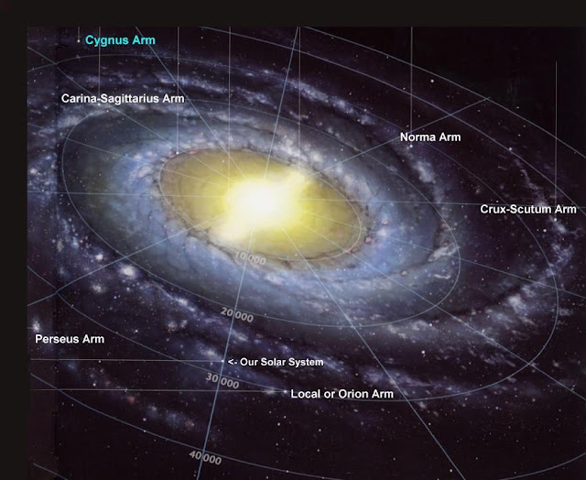
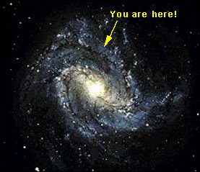
Where are we in the Milky Way?
Our solar system is located in the Orion Arm of the Milky Way Galaxy.

Slide 15
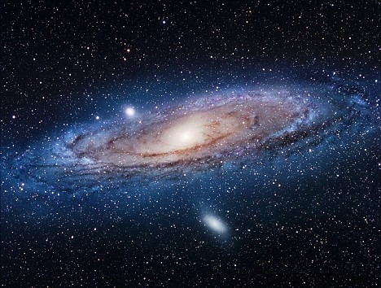
The Milky Way Has A Neighbor!
The Andromeda Galaxy is part of a binary (or double) system of galaxies including ours.

Slide 16
Brain Pop: The Milky Way and The Solar System
http://www.brainpop.com/science/space/milkyway/preview.weml
http://www.brainpop.com/science/space/solarsystem/preview.weml

Slide 17
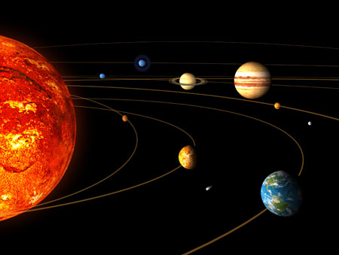
Solar System
A system of planets and other objects orbiting a star. In our solar system, our star is the Sun.

Slide 18
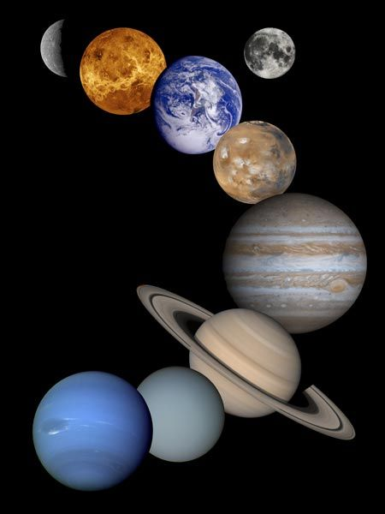
What Is A Planet?
A spherical ball of gas and/or rock that orbits a star. We have 8 planets in our solar system.
Mercury, Venus, Earth, Mars, Jupiter, Saturn, Uranus, and Neptune.

Slide 19
GPS STANDARD S6E1: ELEMENT C
Compare and contrast the planets in terms of their size relative to the Earth, their surface, their atmospheric features, their relative distance from the Sun, and their ability to support life.
(Change only the red terms.)

Slide 20
GPS STANDARD S6E1: ELEMENT D
Explain the motion of objects in the day/night sky in terms of relative position.
(Change only the red terms.)

Slide 21
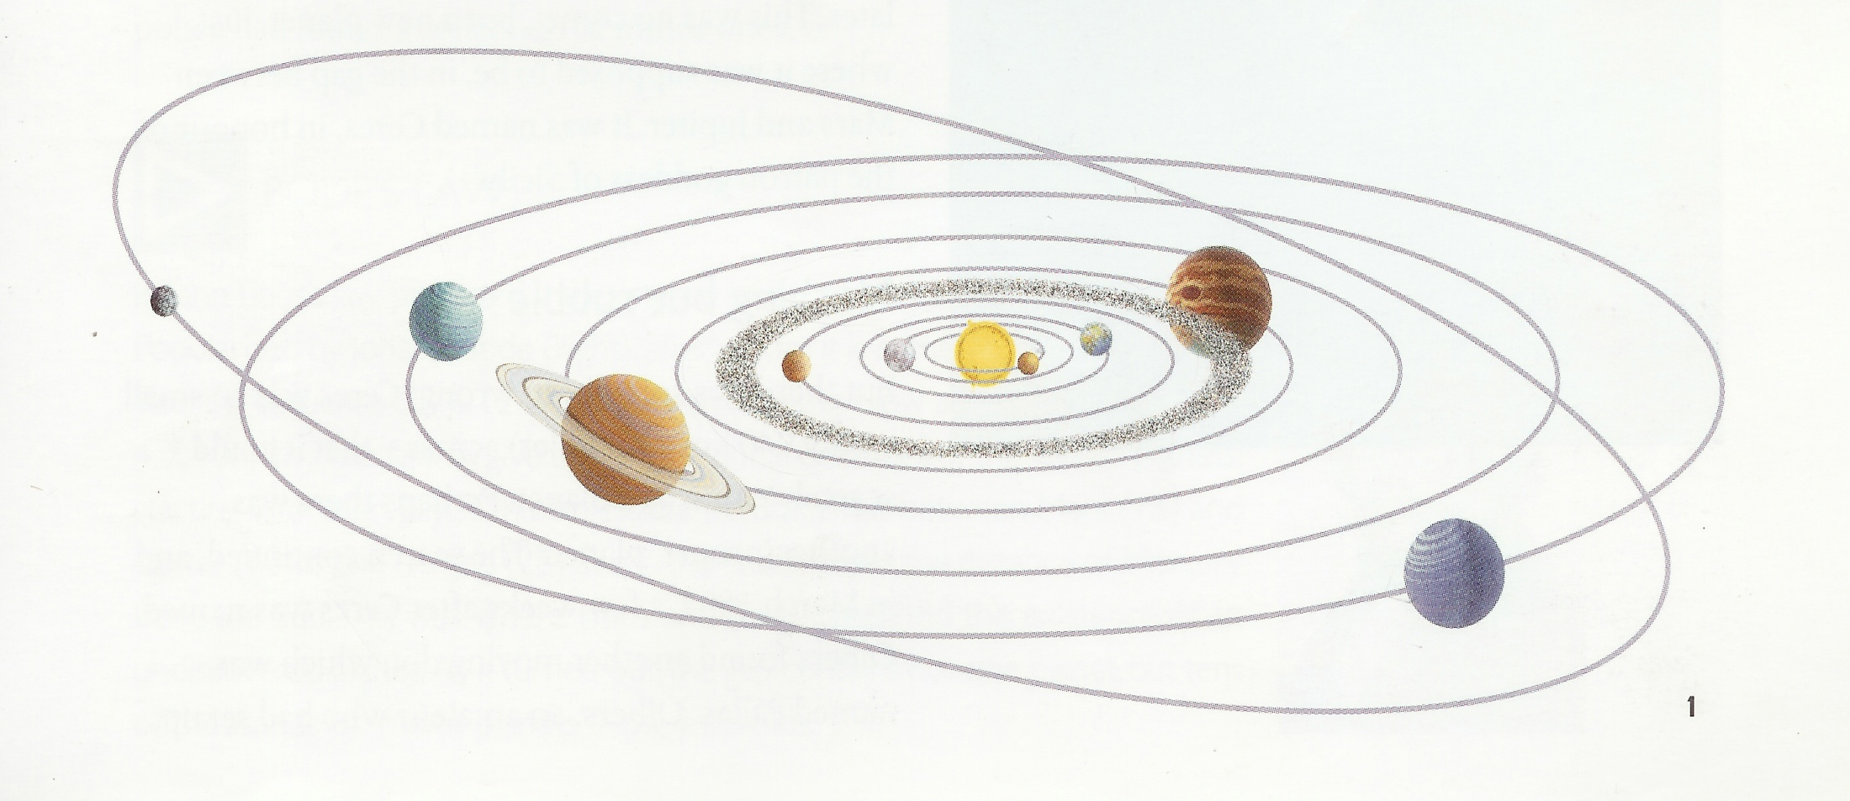
Planetary Movements
All planets move in a an elliptical shape orbit and counterclockwise direction around the sun.

Slide 22
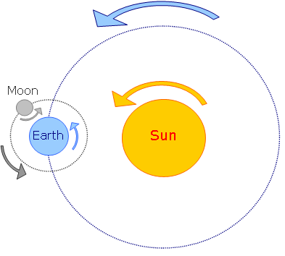
Revolution and Rotation Review
The movement of a body in space around another one is called a revolution.
The spinning of an object in space on its axis is called a rotation.

Slide 23
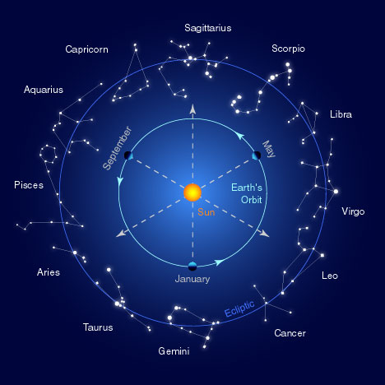
Both Planets and Stars Move
Why can’t we see the stars moving the same way we can see planets moving in our night sky?

Slide 24
GPS STANDARD S6E1: ELEMENT E
Explain that gravity is the force that governs the motion in the solar system.
(Change only the red terms.)

Slide 25
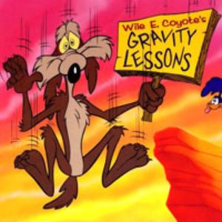
What Keeps Planets In Orbit?
The same force
that
makes objects on
Earth fall to the
ground acts
everywhere in the
universe.

Slide 26
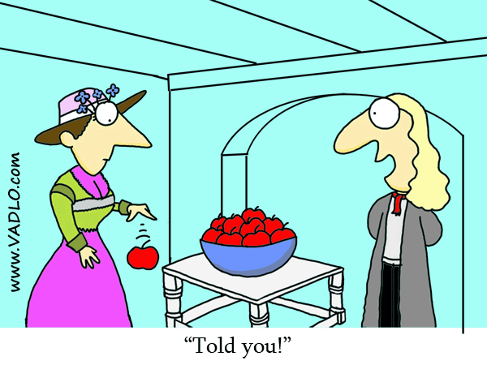
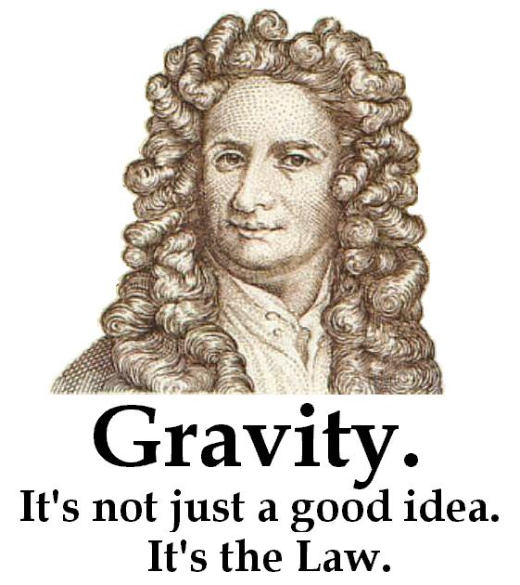
Newton’s Law of Universal Gravitation
Scientist Sir Isaac Newton found out that gravity is a force that pulls all objects towards one another on Earth and also in space.

Slide 27
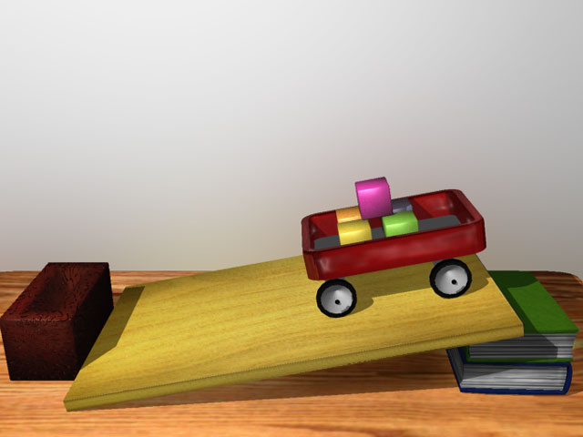
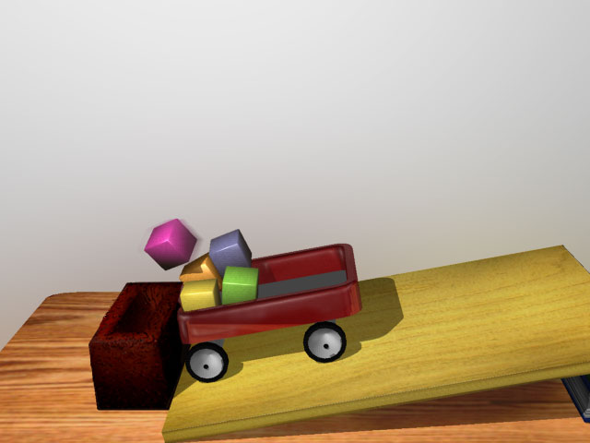
What Keeps The Planets From Being Pulled Into The Sun?
Newton discovered another important law called the Universal Law of Motion.
It states that an object at rest will stay at rest and an object in motion will stay in motion.

Slide 28
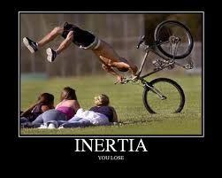
Inertia
The tendency for an object to stay either at rest or in motion is called inertia.

Slide 29
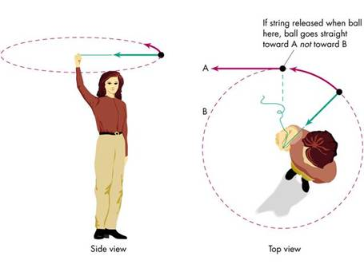
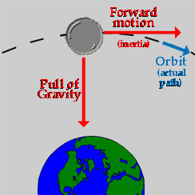
So Why Don’t Planets Or Moons Get Sucked Into A Sun or A Planet?
Gravity and inertia work together to balance each other out keeping planets or moons in their orbits.

Slide 30
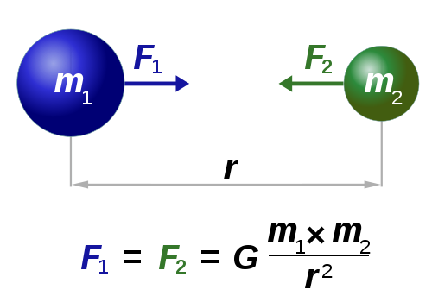
Gravity, Mass, And Distance
The force of attraction between objects, or gravity depends on two things: Mass and Distance

Slide 31
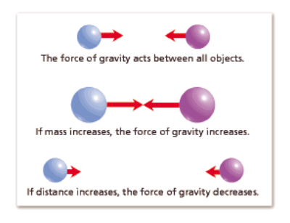
MASS and DISTANCE
The amount of matter in an object.

Slide 32
Study Jams: Gravity and Inertia
http://studyjams.scholastic.com/studyjams/jams/science/solar-system/sgravity-and-inertia.htm

Slide 33
Brain Pop: Isaac Newton and Gravity
http://www.brainpop.com/science/famousscientists/isaacnewton/
http://www.brainpop.com/science/motionsforcesandtime/gravity/

Slide 34
GPS STANDARD S6E1: ELEMENT F
Describe the characteristics of comets, asteroids, and meteors.
(Change only the red terms.)

Slide 35
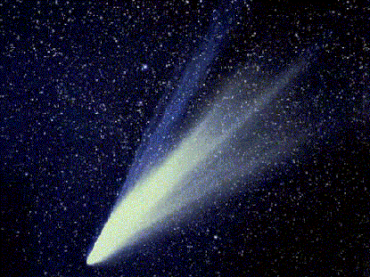
COMETS
Celestial bodies made up of ice, dust, and small gritty particles.
When they get close to the Sun, they heat up and produce a streak called a tail.

Slide 36
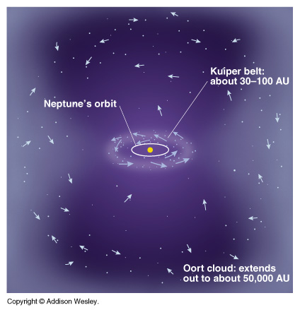
Comets Come From Far Away Places In the Solar System
Located in the very edge of the solar system is the Oort cloud. There may be trillions of comets located there!
Comets have VERY elliptical orbits.

Slide 37
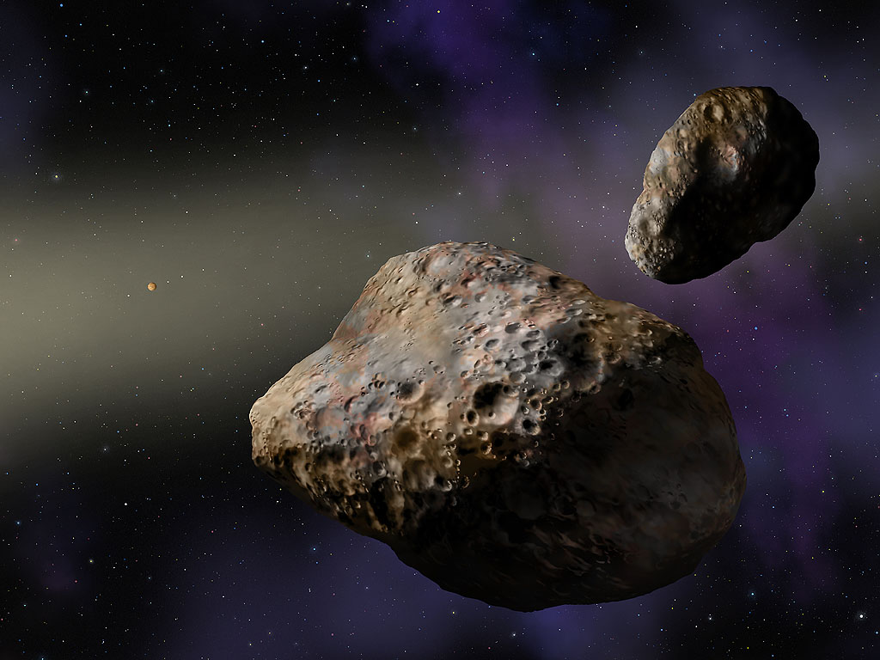
ASTEROIDS
Asteroids are large pieces of space rock with irregular shapes. Most are found between Mars and Jupiter in the asteroid belt.

Slide 38
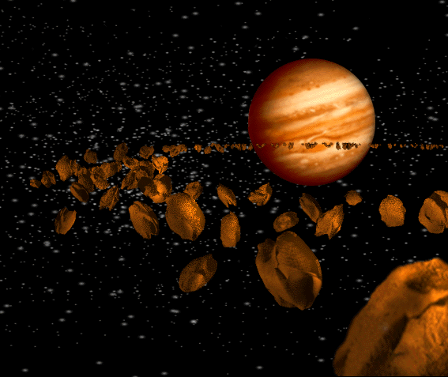
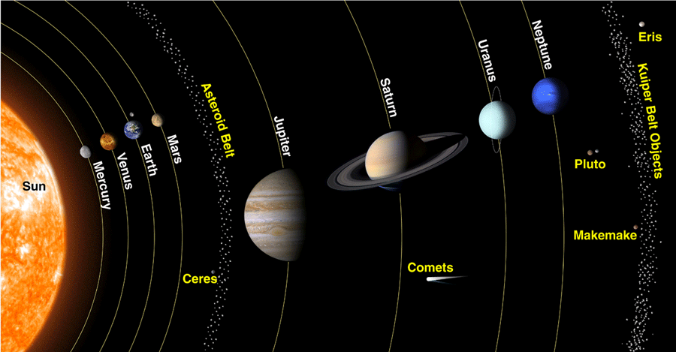
The Asteroid Belt

Slide 39
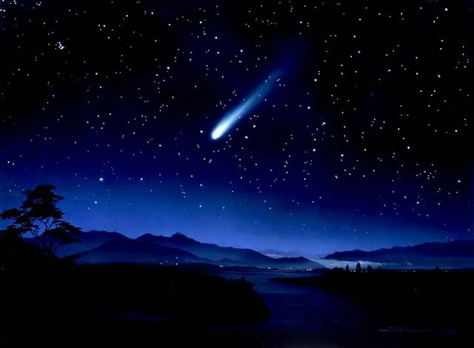
METEOROIDS
Meteoroids are pieces of rock or dust that are smaller than asteroids. When they enter Earth’s atmosphere, they usually burn up and produce streaks of light called METEORS.

Slide 40
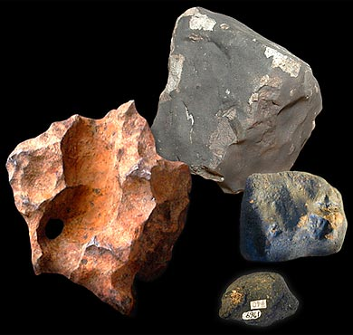
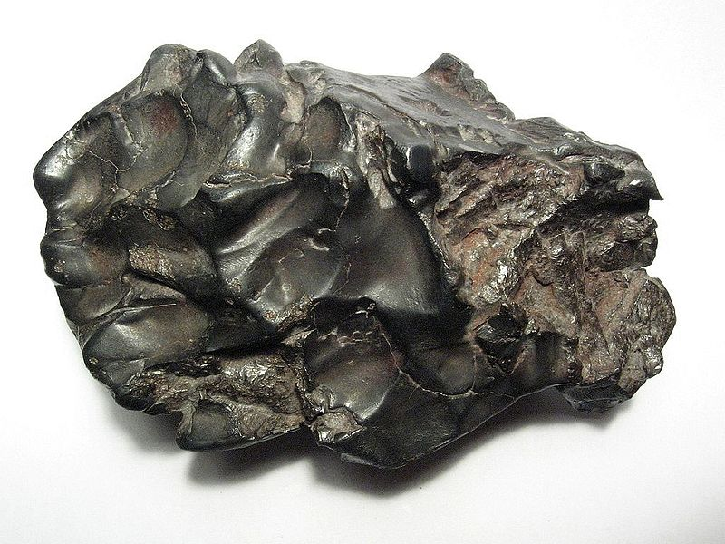
METEORITES
When a meteoroid lands on Earth, we call that a meteorite.

Slide 41
Brain Pop: Asteroids and Comets
http://www.brainpop.com/science/space/asteroids/
http://www.brainpop.com/science/space/comets/

