Slide 1
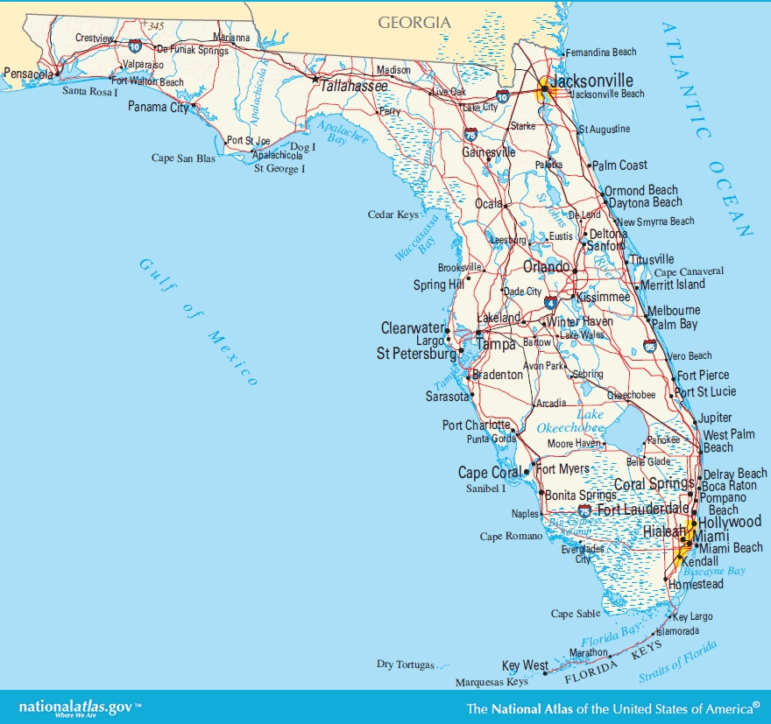
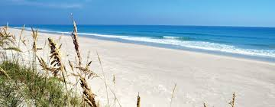
Warm up
Have you ever been to beaches on Gulf of Mexico?
If YES,
Where did you go?
What is your favorite memory?
If NO,
Have you been to another beach area?
What was your favorite memory?

Slide 2
Winds and direction
Last
night
This
morning

Slide 3
Writing Prompt
Name
School: Griffin Middle School
Class: Earth Science
Date: 10/11/18
Dear __________________ Resident,
Answer the following questions
- About you
Where are you from?
Why are you writing?
What is your favorite memory?
Why do you like that area? Why is it important to you?
Hope for future

