Slide 1
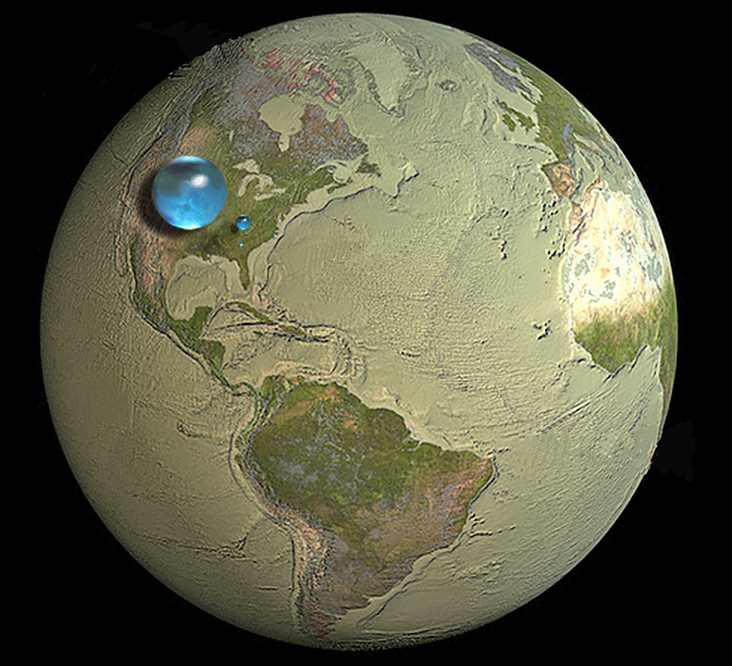
The largest sphere represents all of Earth's water.
The sphere includes all the water in the oceans, ice caps, lakes, and rivers, as well as groundwater, atmospheric water, and even the water in you, your dog, and your tomato plant.
Notes:
Instructional Approach(s): The teacher should present the information on the slide.

Slide 2
How much of the total water is fresh water, which people and many other life forms need to survive?
The blue sphere over Kentucky represents the world's liquid fresh water (groundwater, lakes, swamp water, and rivers).
Notes:
Instructional Approach(s): The teacher should present the information on the slide.

Slide 3
Do you see the "tiny" bubble over Atlanta, Georgia?
That one represents fresh water in all the lakes and rivers on the planet.
Most of the water people and life on earth need every day comes from these surface-water sources.
Notes:
Instructional Approach(s): The teacher should present the information on the slide.

Slide 4
Water on the Earth
About 71% of the earth’s surface is covered with water.
Of the total volume of water on Earth:
97% is saltwater
2% is freshwater frozen in ice caps and glaciers
1% is fresh water in lakes and streams, groundwater, and water vapor in the atmosphere
In general, most of the earth’s water is located in the oceans as saltwater . Most of the freshwater on Earth is located in glaciers and ice caps. Lesser amounts are found in atmospheric moisture, rivers, lakes, streams, and groundwater.
Most of the freshwater on Earth is located in glaciers and ice caps.
Notes:
Instructional Approach(s): The teacher should present the information on the slide while the students record the important information on their notes.

Slide 5
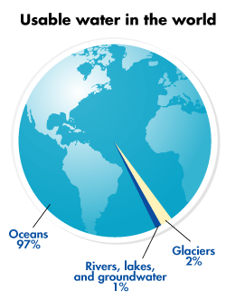
Notes:
Instructional Approach(s): The teacher should use the graph on the slide to illustrate the amount of usable water in the world.

Slide 6
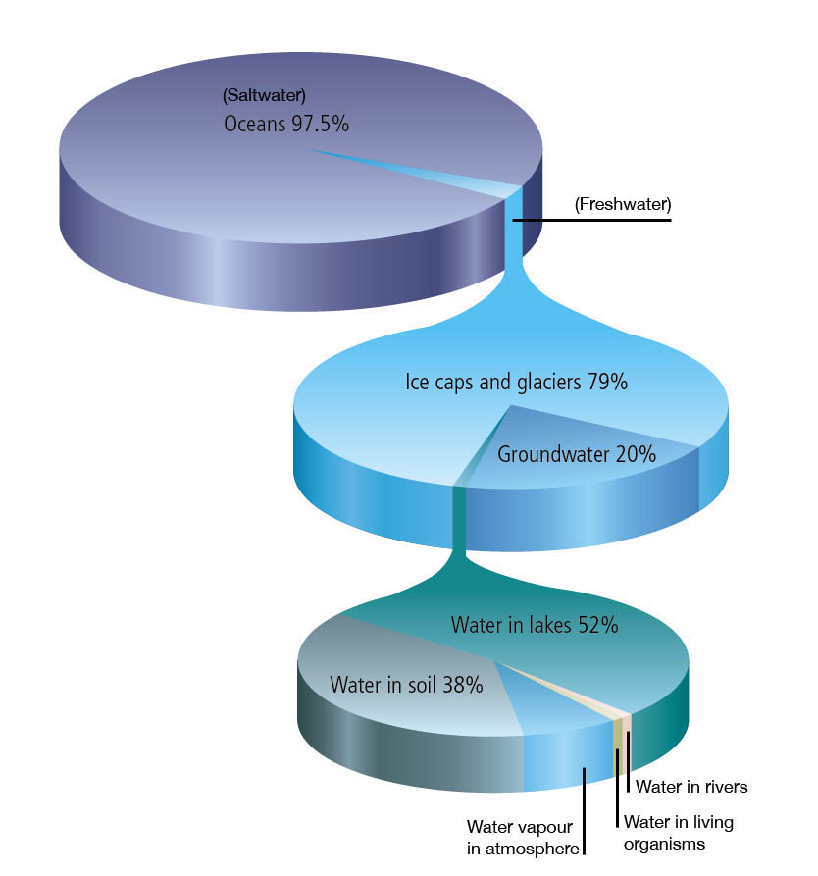
This pie chart represents all the water on earth:
97.5% saltwater
2.5% freshwater
This pie chart represents all the fresh water on earth:
79% ice caps and glaciers
20% groundwater
1% AVAILABLE water
Most available water is located in rivers and streams
This pie chart represents all the available water on earth
Notes:
Instructional Approach(s): The teacher should use the graph on the slide to illustrate the amount and types of water on the earth.

Slide 7
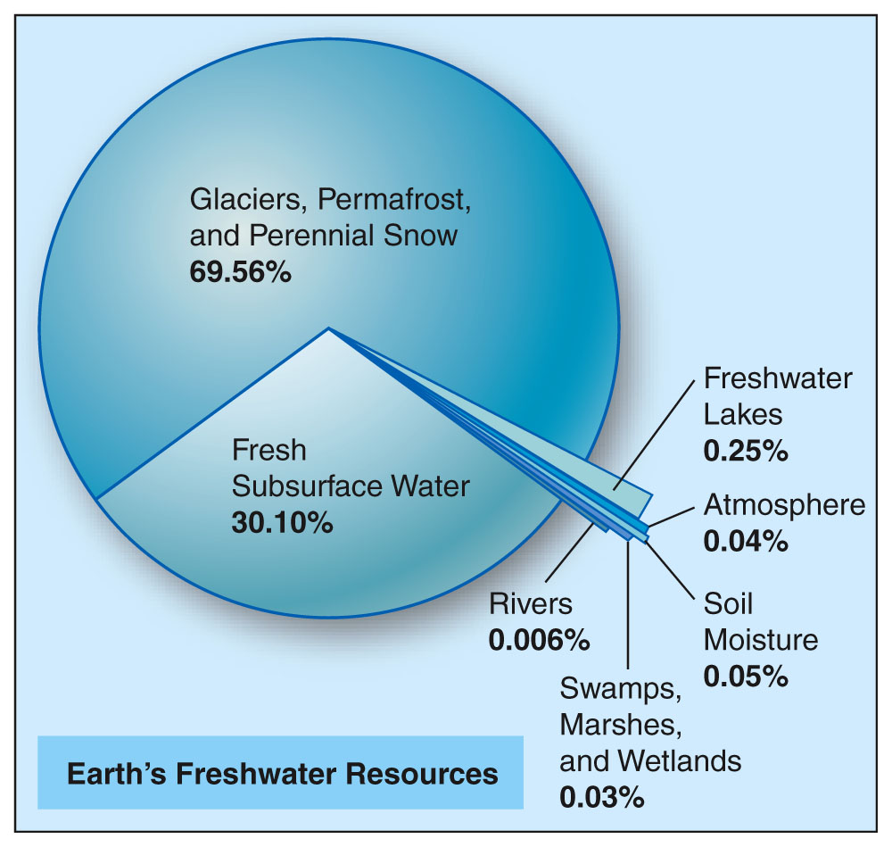
Most available water is located in rivers and streams
Notes:
Instructional Approach(s): The teacher should use the graph on the slide to illustrate the amount and types of water on the earth.

Slide 8
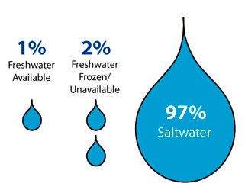
Notes:
Instructional Approach(s): The teacher should present the information on the slide while the students record the important information on their notes.

Slide 9
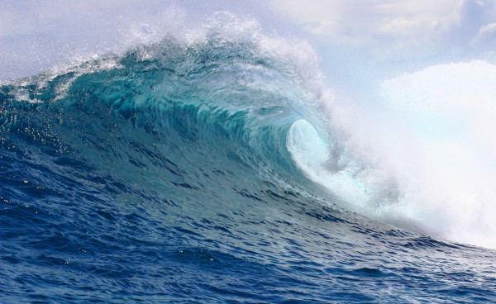
Chemical Composition of Ocean Water
Notes:
Instructional Approach(s): The teacher should use the slide as a transition into the next part of the lesson, the chemical composition of ocean water

Slide 10
What does the word composition mean? What are some synonyms?
Structure
Make-up
Parts
Pieces
Content
Components
Notes:
Instructional Approach(s): The teacher should pose the question on the slide to the class. The teacher can either ask for volunteers or call on specific students to answer the question. When ready, click the mouse to reveal some synonyms for composition.

Slide 11
What percent of ocean water is salt?
Notes:
Instructional Approach(s): The teacher should pose the question to the class and gather a few student responses

Slide 12
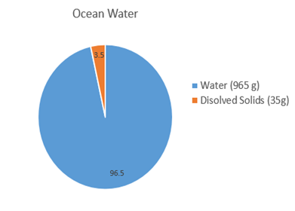
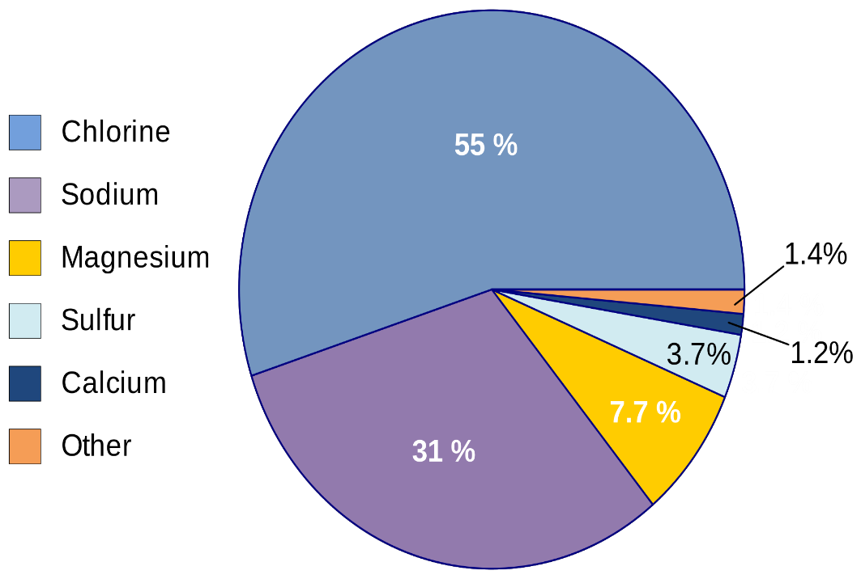
Chemical Composition of Ocean Water
Notes:
Instructional Approach(s): The teacher should present the information on the slide while the students record the information on their notes.

Slide 13
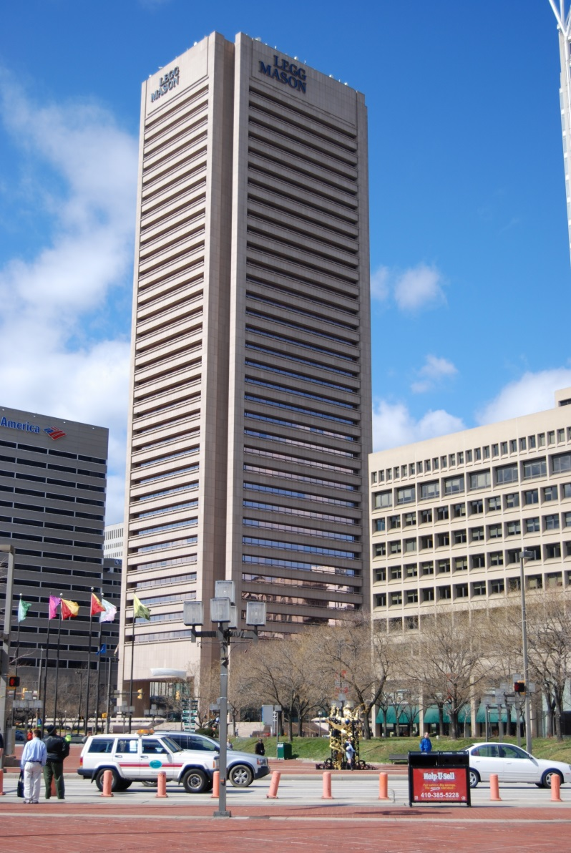
By some estimates, if the salt in the ocean could be removed and spread evenly over the Earth's land surface it would form a layer more than 500 feet (166 meters) thick, about the height of a 40-story office building.
But, where did all this salt come from?
Notes:
Instructional Approach(s): The teacher should present the information on the slide.

Slide 14
From precipitation to the land to the rivers to the sea…
The rain that falls on the land contains some dissolved carbon dioxide from the surrounding air. This causes the rainwater to be slightly acidic.
The rain physically breaks down the rock and the acids chemically break down the rocks. Rain then carries the dissolved salts and minerals along as it flows. The salts in the runoff are carried to the streams and rivers and then to the ocean.
Notes:
Instructional Approach(s): The teacher should present the information on the slide while the students record the important information on their notes.

Slide 15
From precipitation to the land to the rivers to the sea…
Many of the dissolved salts are used by organisms in the ocean and are removed from the water. Others are not used up and are left for long periods of time where their concentrations increase over time.
Notes:
Instructional Approach(s): The teacher should present the information on the slide while the students record the important information on their notes.

Slide 16
Salt from below…
Hydrothermal vents are recently-discovered features on the ocean seafloor that contribute dissolved minerals to the oceans.
These vents are the “exit points” on the ocean floor from which sea water that has seeped into the rocks of the oceanic crust has become hotter, has dissolved some of the minerals from the crust, and then flows back into the ocean.
http://www.youtube.com/watch?v=D69hGvCsWgA&list=PL88CB33C02CCF3D39&index=1
Notes:
Instructional Approach(s): The teacher should present the information on the slide while the students record the important information on their notes.

Slide 18
Eruption of Volcanoes Underwater…
Similar to the previous process, during underwater volcano eruptions, seawater reacts with hot rock and causes some minerals to be dissolved into the sea water.
http://www.youtube.com/watch?v=U51cY6iod3U&index=5&list=PL88CB33C02CCF3D39
Notes:
Instructional Approach(s): The teacher should present the information on the slide while the students record the important information on their notes.

Slide 20
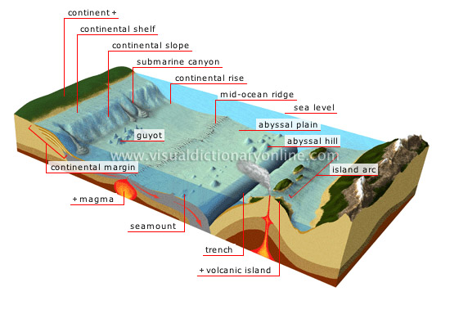
Ocean Features

Slide 21
Our AMAZING Oceans
Area: 140 million square miles (71% of the surface of earth)
Average depth: 12,200 feet
Deepest point: 36,198 feet in the Marianas Trench on western side of South America
The ocean ridges form a great mountain range, almost 40,000 miles
Highest Mountain: Mauna Kea, Hawaii, rises 33,474 feet from its base on the ocean floor; only 13,680 feet are above sea level.

Slide 22
Features of the Ocean Floor
What is the deepest place in our oceans?
What type of plate boundary makes deep oceanic trenches?
Where is the sediment carried by rivers deposited in our oceans?
What type of plate boundary is located at mid-ocean ridges?
How does Earth’s climate effect sea levels?

Slide 23
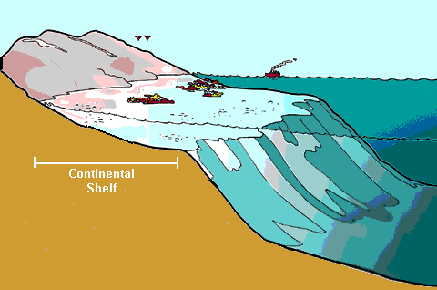
1. Continental Margin- Made up of the continental shelf, slope, and rise. This is where the continent drops off to meet the ocean crust.
2. Continental Shelf- gently sloping edge of the continent. Ocean is shallow on the shelf.

Slide 24
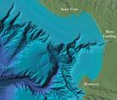
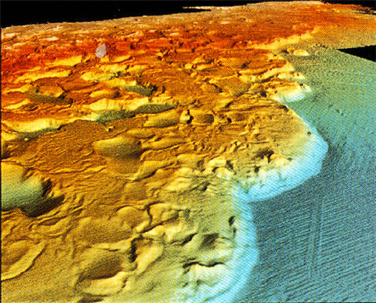
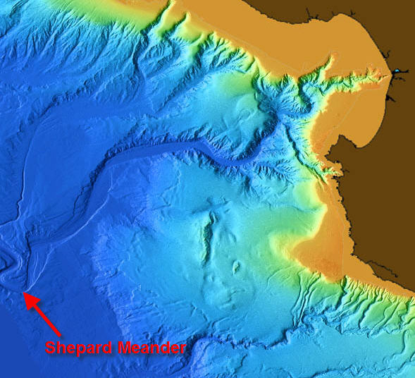
3. Continental Slope- the steep drop-off at the edge of a continent.
4. Continental Rise- where sediment builds up at the bottom of the continental slope.
5. Abyssal Plain- relative smooth plains on the ocean floor. Ocean level is deep in these areas.

Slide 25
6. Mid-ocean Ridges- chains of volcanic mountains that run through the middle of the oceans.
7. Rift Valleys- low valleys in the middle of mid-ocean ridges where two ocean plates are pulled apart.
8. Trench- the deepest places in the ocean. They form from one crustal plate plunging under another.
9. Seamount- An underwater volcanic mountain
10. Guyot- An underwater plateau that has sunk beneath the ocean’s surface. Originally formed from volcanic activity, it’s top has been flattened from wave action.

Slide 26
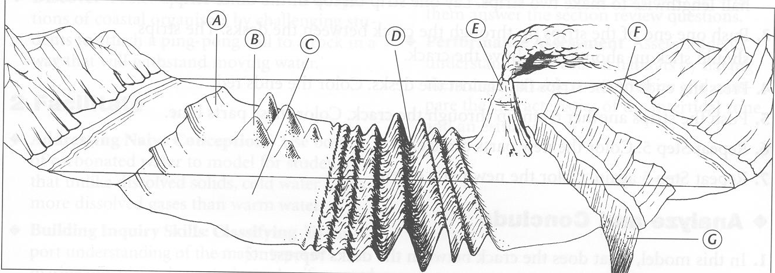
Identify the Features

