Slide 1
Hydrology Study Power Point

Slide 2
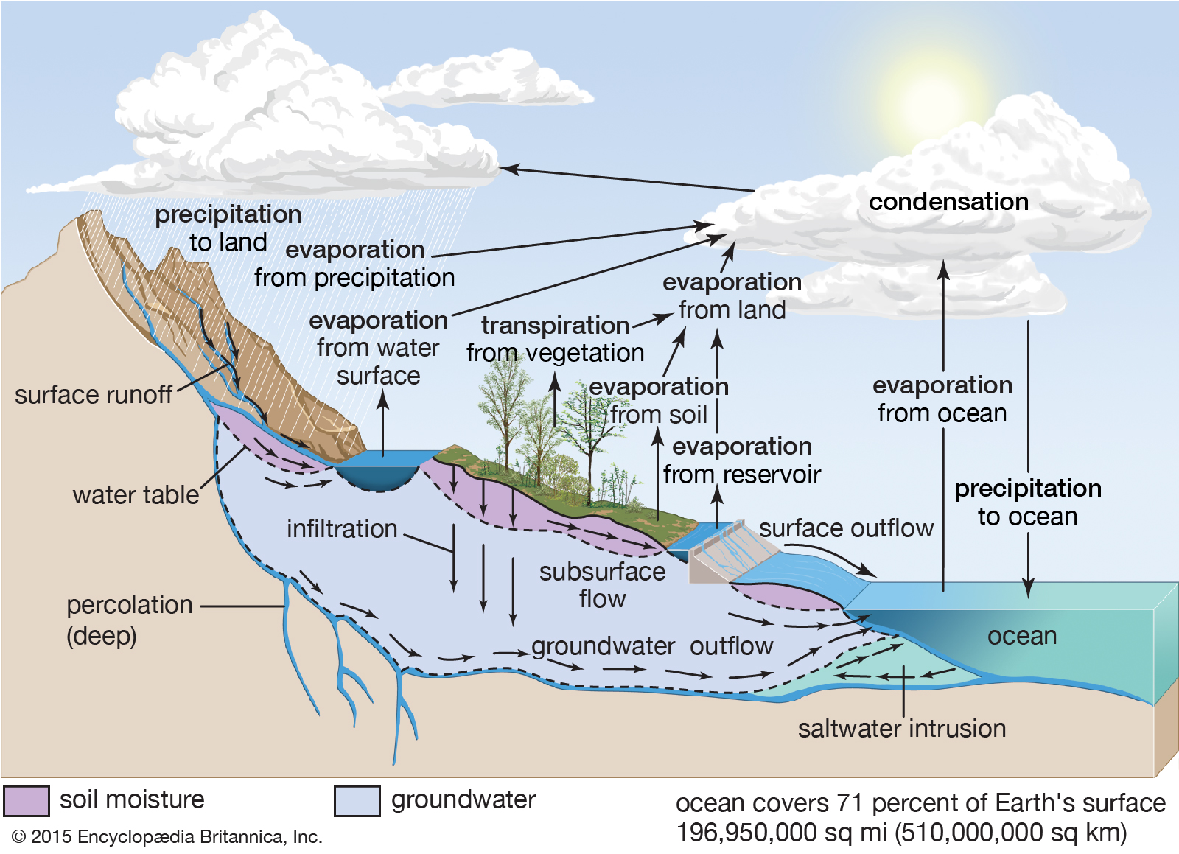
Water Cycle
The water cycle is the continual movement of water from one place to another.
Water changes it’s state of matter as it travels through the process.
The amount of water does not change. It is the same amount that has been around since the world was created. Simply being recycled and cleaned as it moves.

Slide 3
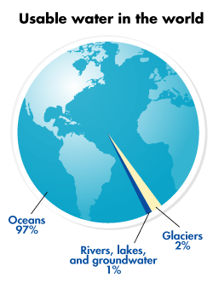
Water of the World
Even though approximately 70% of the world is covered in water, the majority of the water is unusable.
- 97% salt water
Most fresh water is still unusable as it is locked up in glaciers, icecaps, and permafrost.
- 2%
The only fresh water we have remaining is in rivers, lakes, and groundwater.
- 1%
Notes:
Instructional Approach(s): The teacher should use the graph on the slide to illustrate the amount of usable water in the world.

Slide 4
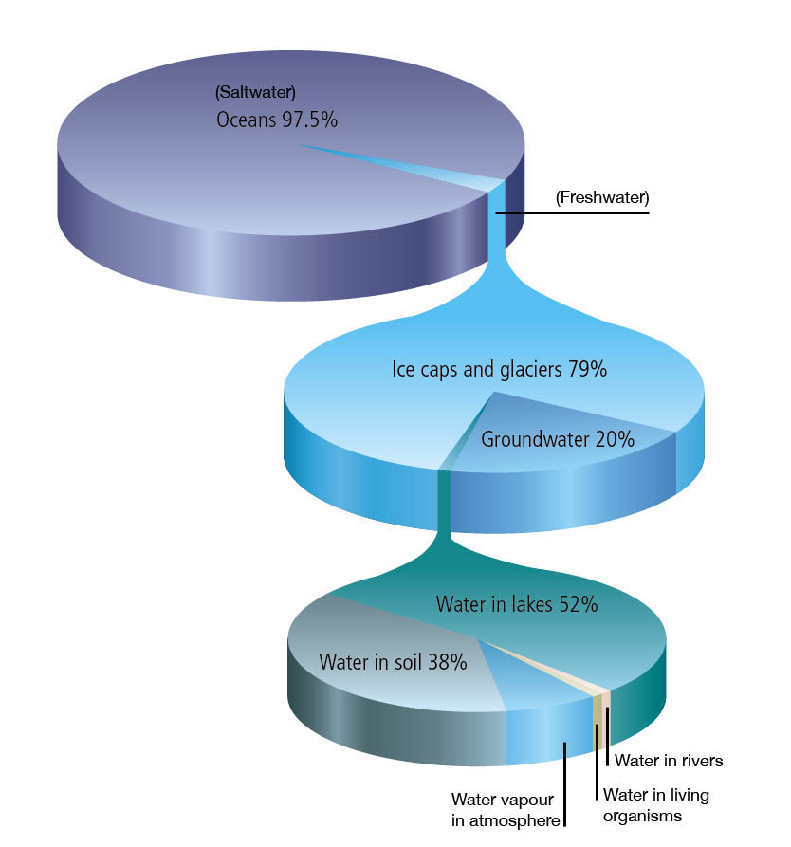
This pie chart represents all the water on earth:
97.5% saltwater
2.5% freshwater
This pie chart represents all the fresh water on earth:
79% ice caps and glaciers
20% groundwater
1% AVAILABLE water
Most available water is located in rivers and streams
This pie chart represents all the available water on earth
Notes:
Instructional Approach(s): The teacher should use the graph on the slide to illustrate the amount and types of water on the earth.

Slide 5
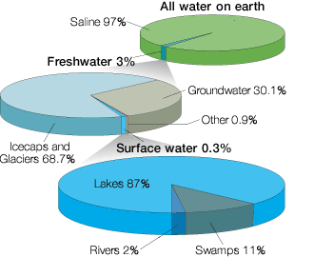
Most available water is located in rivers and streams
Notes:
Instructional Approach(s): The teacher should use the graph on the slide to illustrate the amount and types of water on the earth.

Slide 6
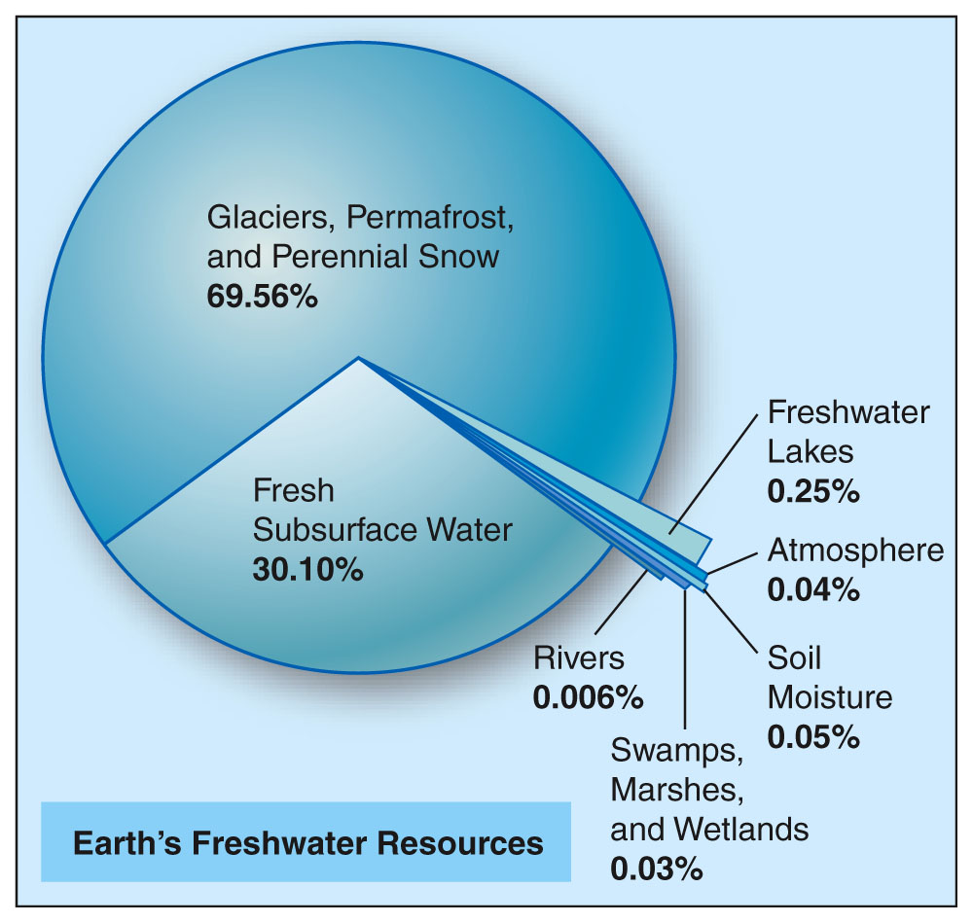
Most available water is located in rivers and streams
Notes:
Instructional Approach(s): The teacher should use the graph on the slide to illustrate the amount and types of water on the earth.

Slide 7
Water on the Earth
Water is not evenly distributed, and most of it is unsuitable for drinking.
We use less than 1% of the water on Earth for drinking and personal hygiene. We also use this fresh water for agriculture, fisheries, transportation, heating and cooling, manufacturing, and many other purposes.
Unless we use our freshwater supply wisely, rivers, lakes and groundwater can be depleted or polluted, becoming unusable or unsuitable for life.
Notes:
Instructional Approach(s): The teacher should present the information on the slide while the students record the important information on their notes.

Slide 8
Continents and Oceans

Slide 9
How does the ocean get salty?
The ocean gains minerals from:
Surface runoff
Hydrothermal vents
Underwater volcanoes

Slide 12
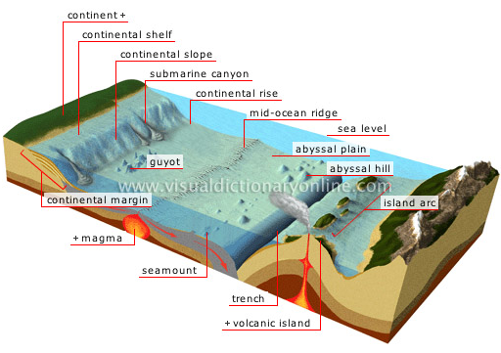
Ocean Features

Slide 13
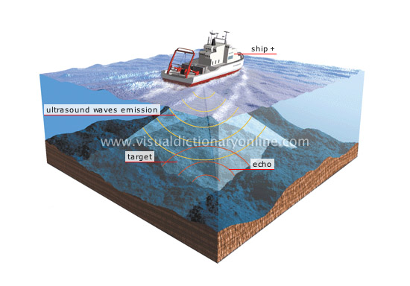
Sound Navigation and Ranging
A. SONAR

Slide 14
B. Satellites: provide great range and speed in collecting data

Slide 15
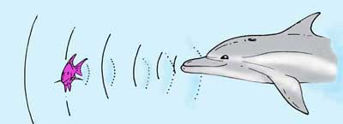
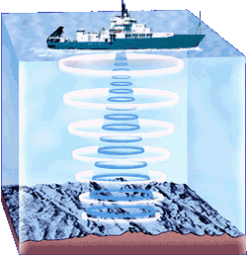
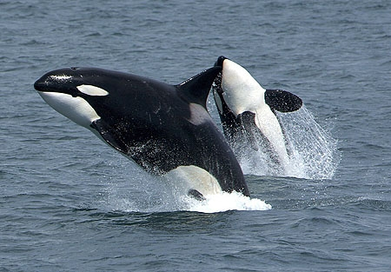
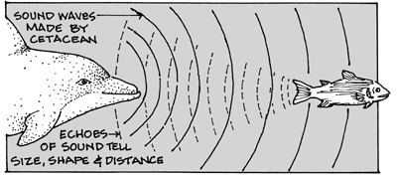
C. Echo Sounding
Shapes can be determined by measuring the time it takes for the sound to “bounce back”
Some marine life also uses this method.

Slide 16
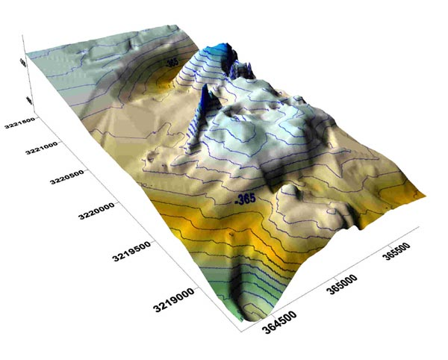
Sonar helps us map the ocean floor

Slide 17
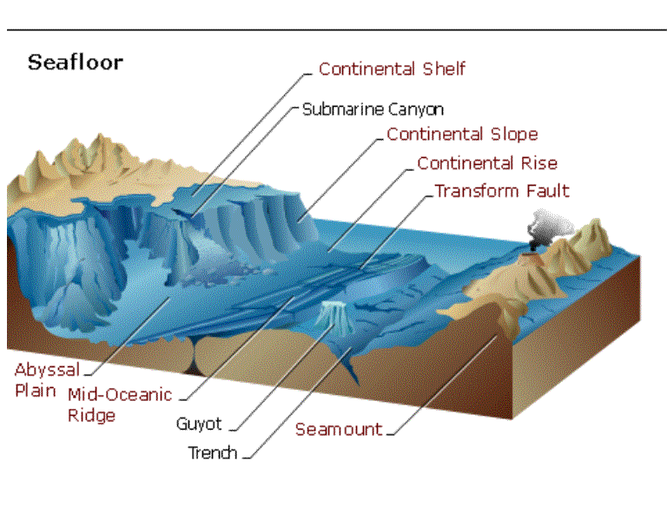

Slide 18
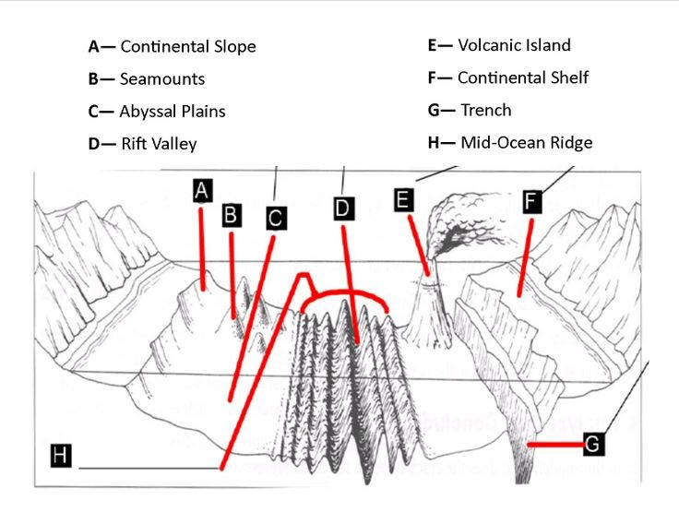
Features of the Ocean Floor
What is the deepest place in our oceans?
What type of plate boundary makes deep oceanic trenches?
Where is the sediment carried by rivers deposited in our oceans?
What type of plate boundary is located at mid-ocean ridges?
How does Earth’s climate effect sea levels?

Slide 20
Quiz Yourself

