Slide 2
Ms. Brown’s and Mr. Gunn’s 6th Grade earth science
Contact Information:
Email: laquincia.brown@cobbk12.org
dmario.gunn@cobbk12.org
Blog: www.griffinsixthscience.weebly.com
Phone: (404)-734-4105

Slide 3
What’s Happening……

Slide 4
Grading policy
GRADING:
Tests, Projects, Labs, Essays 30% A 90-100%
Formative (Classwork, Homework) 70% B 80-89%
C 74-79%
D 70-73%
F 69% and below

Slide 5
Access to Synergy☺
Synergy is a great way to keep up with your child’s academic progress.
*If you have any questions regarding synergy, a table will be set up in the learning commons.

Slide 6
How To Access my/our blog
1) Go to http://www.cobbk12.org/Griffin/
2) On the griffin website, click on faculty and staff at the top.

Slide 7
How To Access my blog
3) Next, go down to Grade 6 teachers
4) Click on Blog next to my name- Laquincia Brown

Slide 8
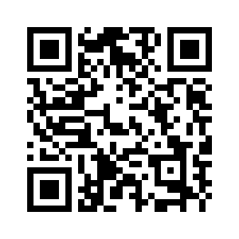
How To Access team blog
3) Go down to Science Team Blog
4) Click on Blog next to Science Team
5) Here’s the QR to access it

Slide 9
A HUGE THANK YOU FOR ALL YOU DO!!!!!!!

